Slide 1
OPTICAL ILLUSION
How does your brain perceive objects?

Slide 2
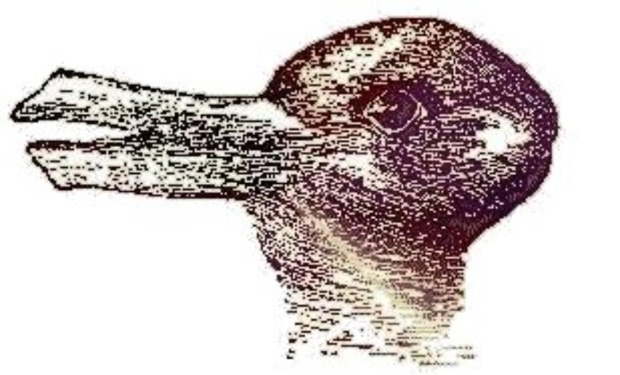
What is it?
Duck or bunny

Slide 3
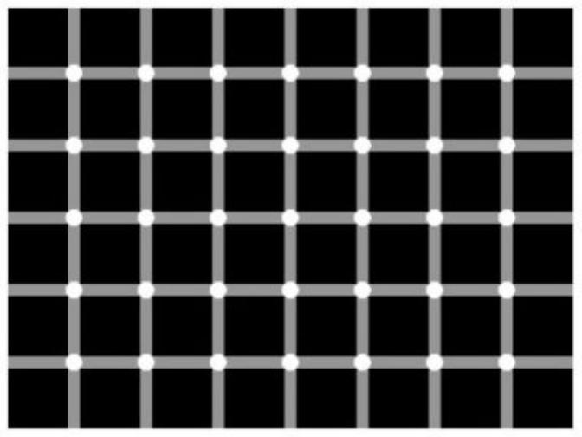
Count the black dots.

Slide 4
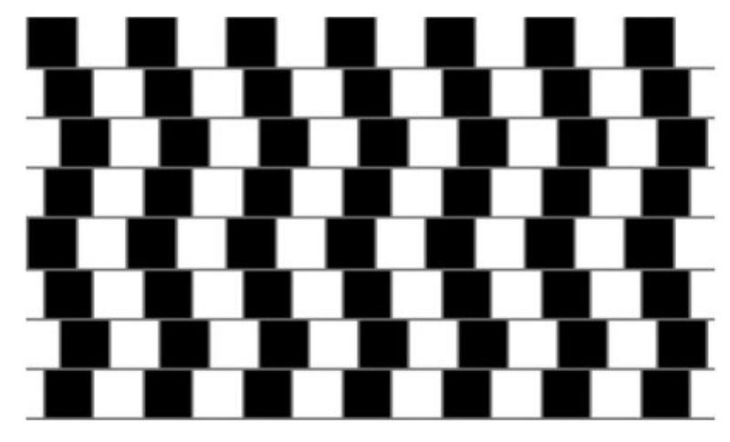
Are the lines straight or diagonal?

Slide 5
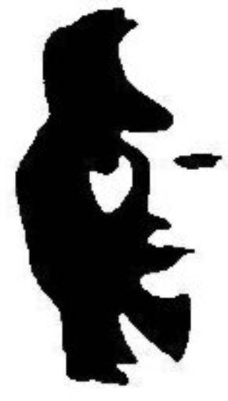
What is it?
Man playing horn, or a woman’s face?

Slide 6
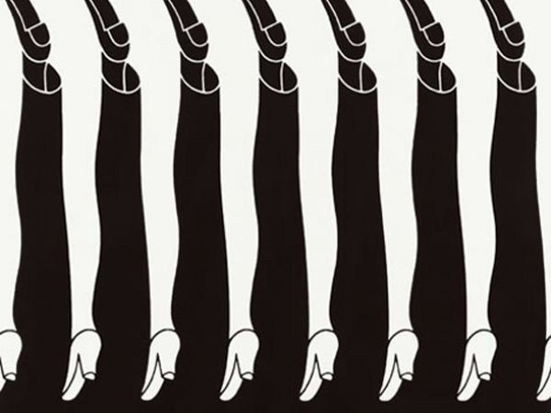

Slide 7
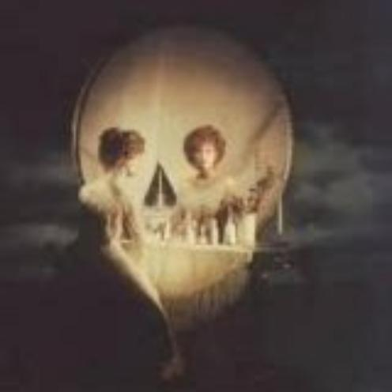
What is it?
Skull or woman looking into a mirror?

Slide 8
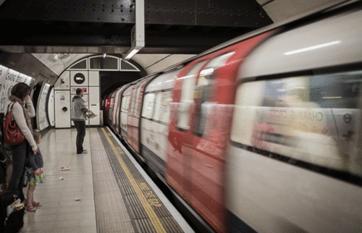
Which direction is the train traveling?

Slide 9
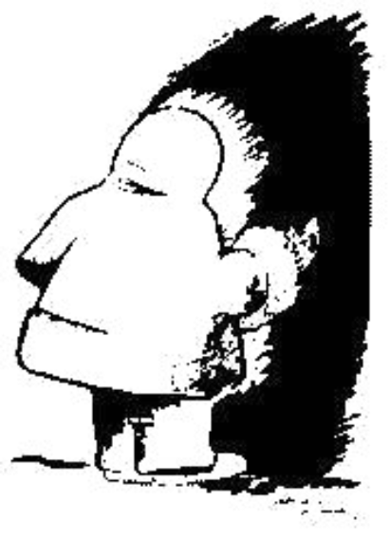
What is it?
Native american profile or eskimo entering a cave?

Slide 10
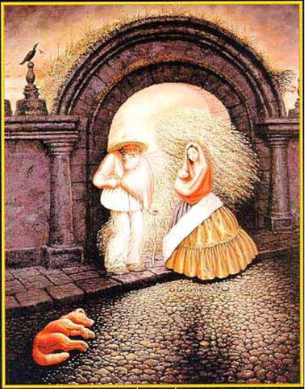
What is it?
One man or several people?

Slide 11

What is it?
Face or the word liar?

Slide 12

What word do you see?
LIFT

Slide 13
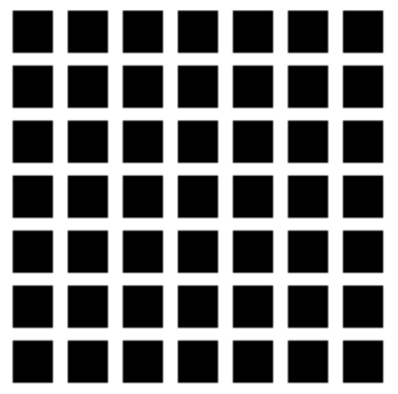
Grey Squares?

Slide 14
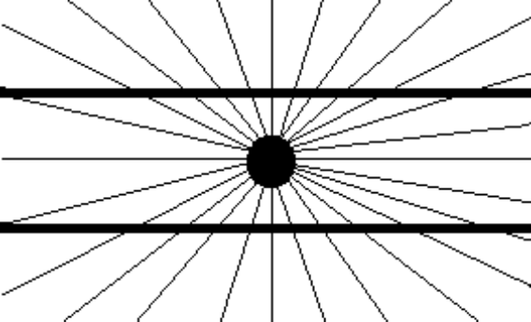
Are the lines parallel or curved?

Slide 15
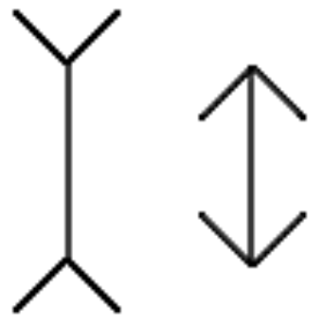
Which is longer?

Slide 16
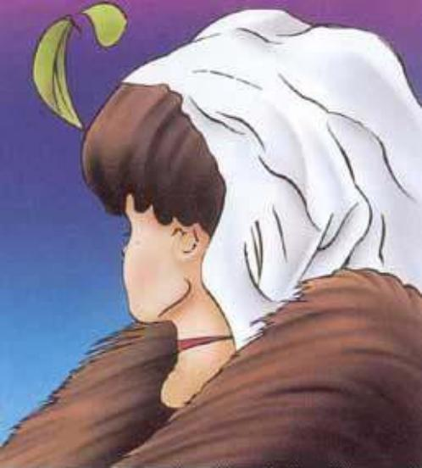
What is it?
Young girl or old woman?

Slide 17
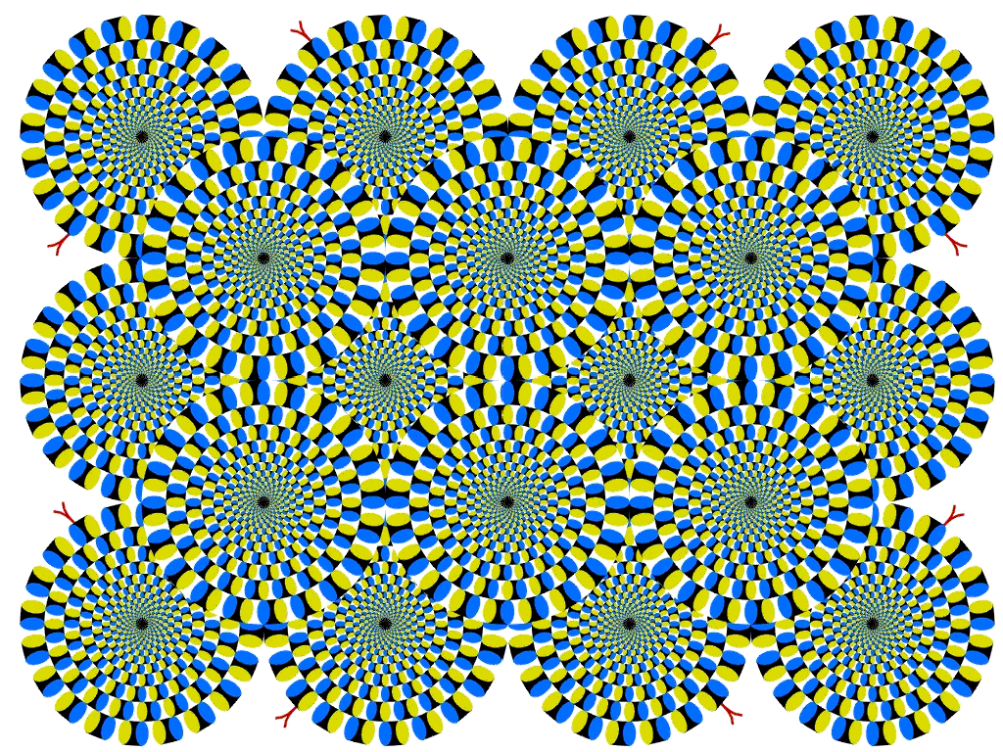

Slide 18
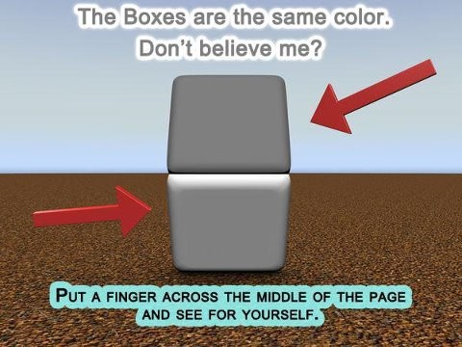

Slide 19
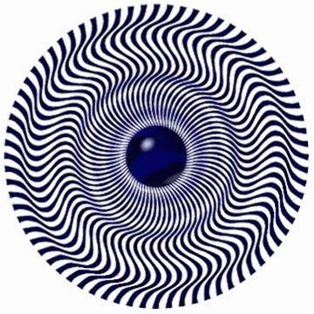
Move your head back and forth.

Slide 20
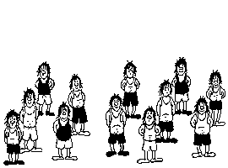
And here is another type of illusion.
Count the people in the picture below.
After they shift, count them again!

Slide 21
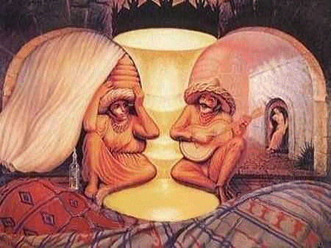

Slide 22
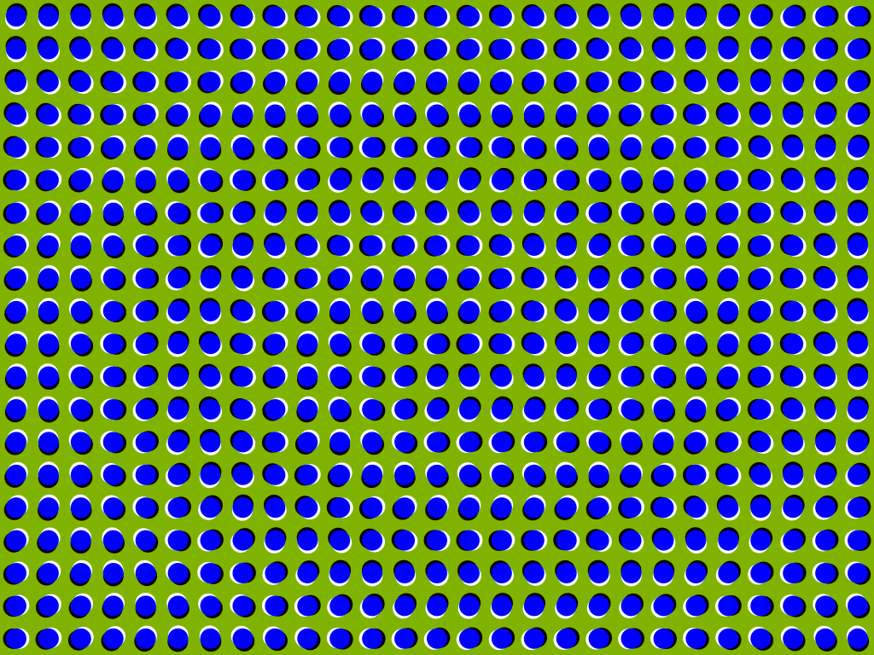

Slide 23
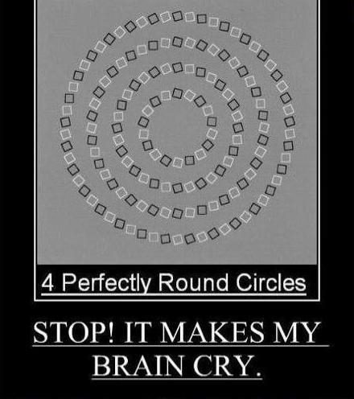

Slide 24
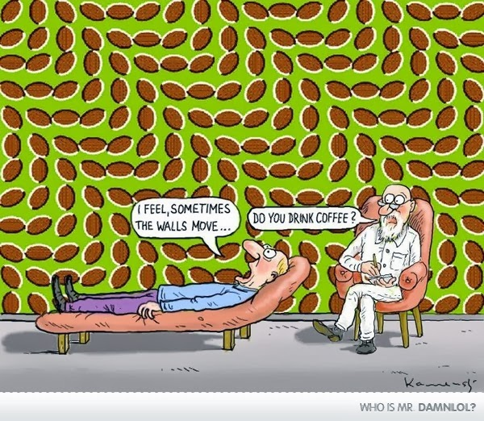

Slide 25
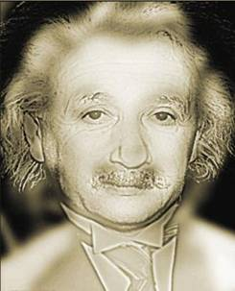
Your distance from this photo determines what you see. Try stepping closer (or farther away)

Slide 26
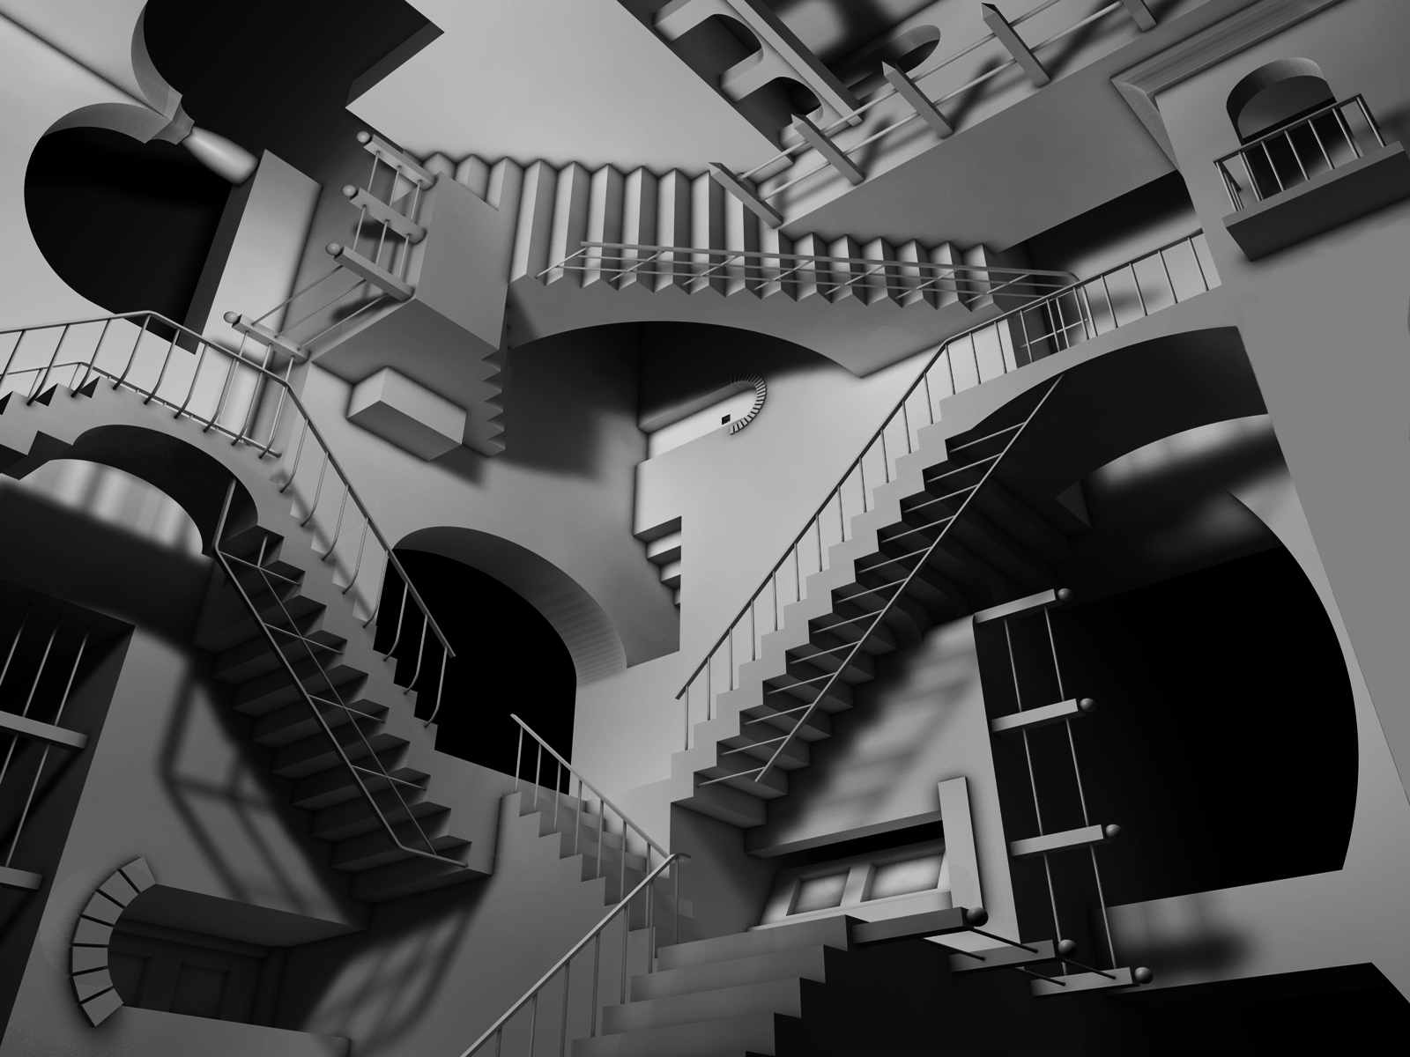

Slide 28
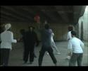

Slide 29
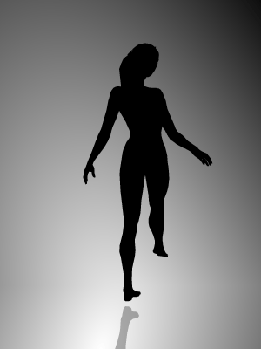
Silhouettes
http://www.michaelbach.de/ot/sze_silhouette/index.html

Slide 30
Brain Game at NatGeo
Brain Heiroglyphics

