Slide 1
Muscle Review

Slide 2
For each muscle, you will point to it’s location on your own body.

Slide 3
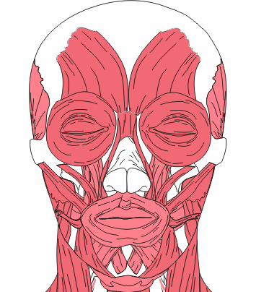
Masseter
Closes Jaw, Chewing

Slide 4
Orbicularis oculi
Closes Eyes

Slide 5
Orbicularis oris
Kissing, closes & protrudes lips

Slide 6
Frontalis
Raises Eyebrows

Slide 7
Zygomaticus
Smiling, Raises corners of mouth

Slide 8
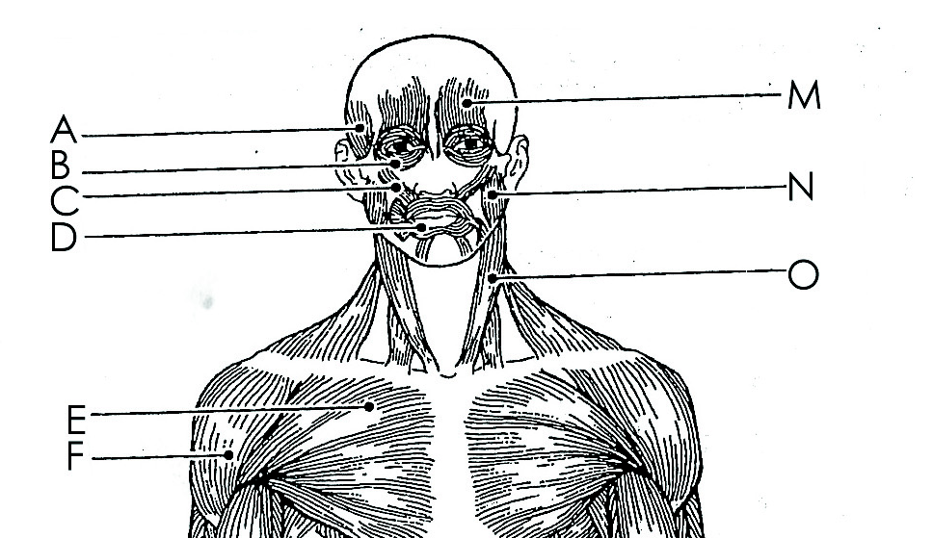
Sternocleidomastoid
Turns head

Slide 9
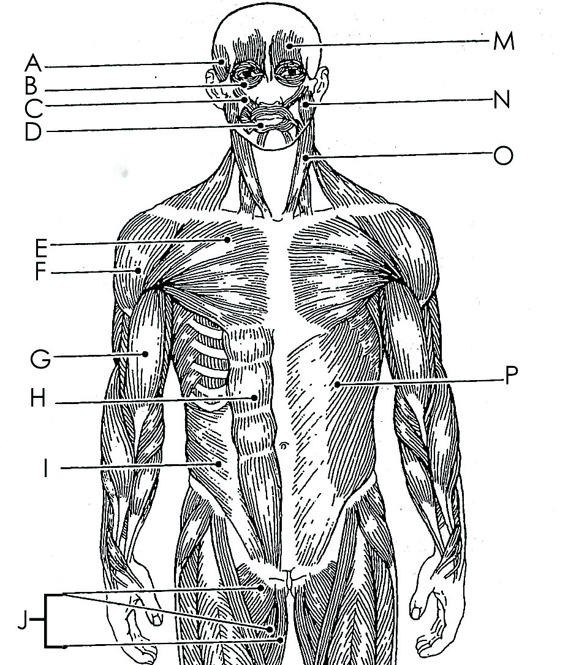
Biceps brachii
Flexes arm

Slide 10
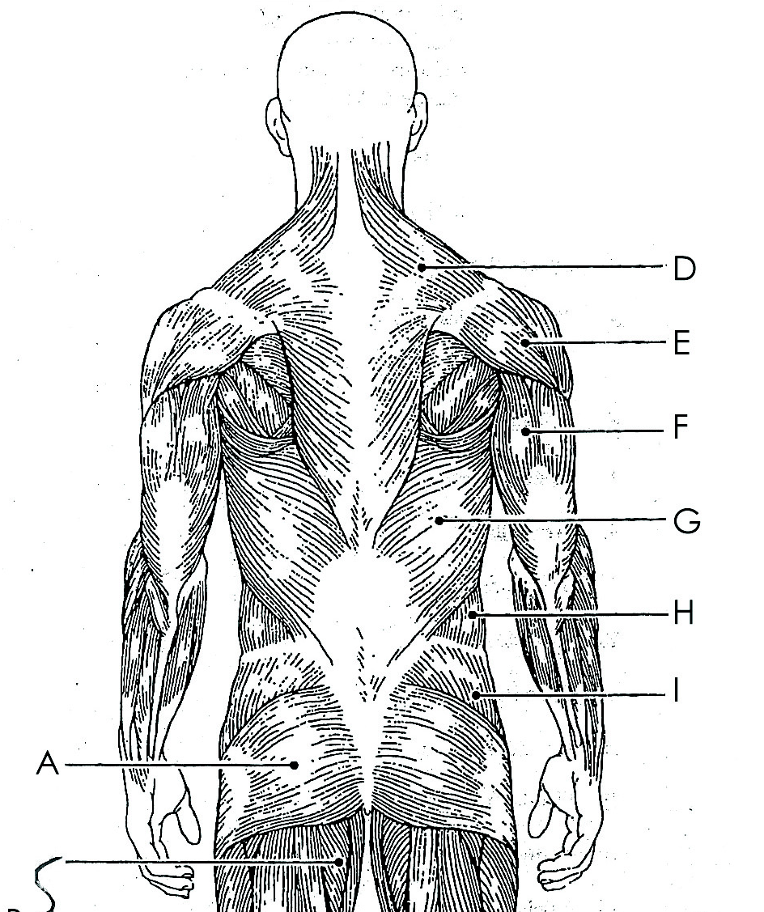
Triceps brachii
Extends arm

Slide 11
Deltoid
Abducts arm

Slide 12
Pectoralis major

Slide 13
Rectus abdominus
“6 pack” muscles

Slide 14
External oblique

Slide 15
Stand up!!!

Slide 16
Gluteus maximus

Slide 17
Trapezius

Slide 18
Latissimus dorsi

Slide 19
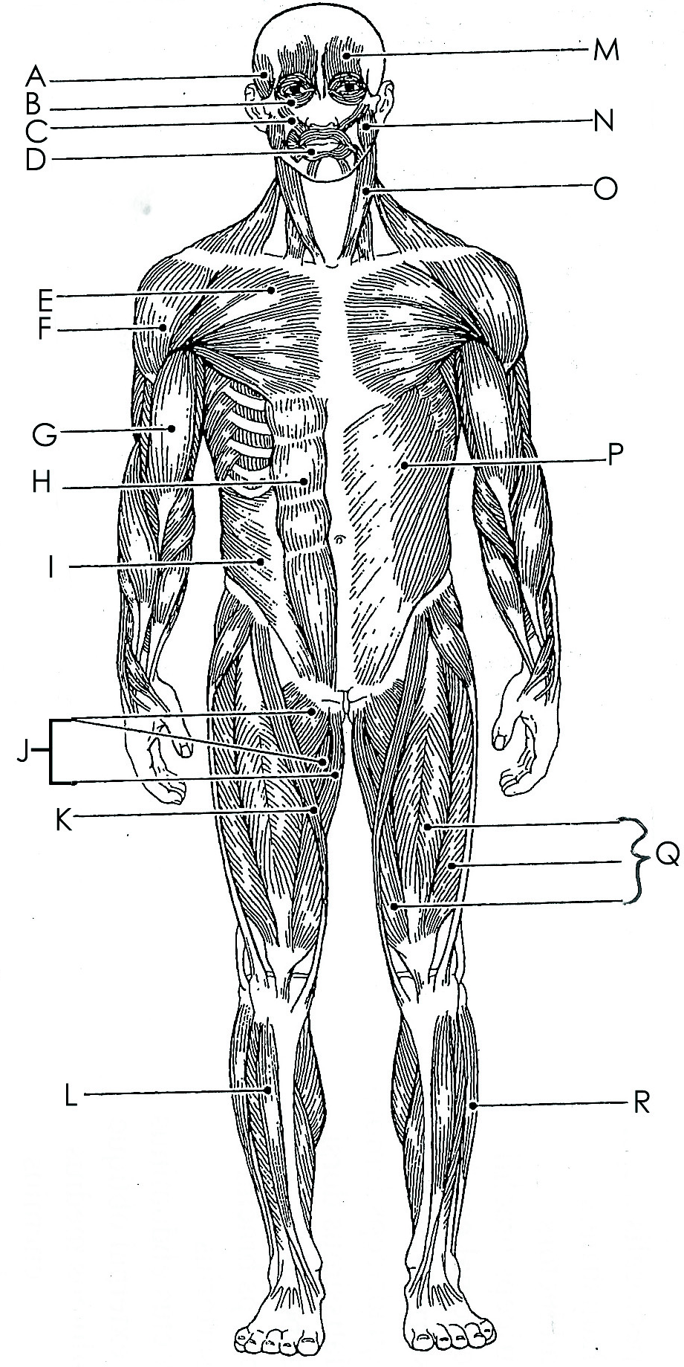
Quadriceps
Extends leg

Slide 20
Sartorius

Slide 21
Adductor group
Adducts leg

Slide 22
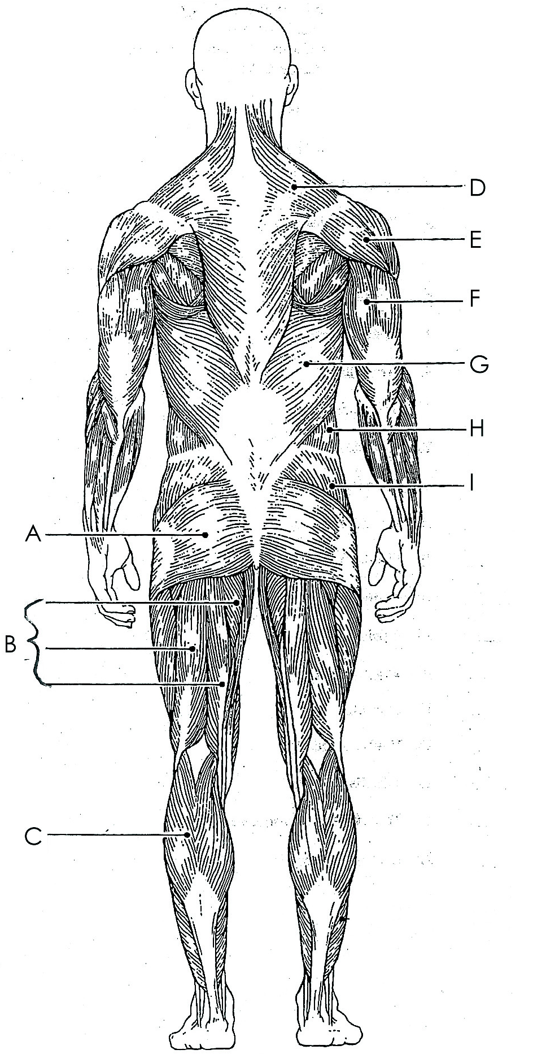
Hamstrings group
Extends the thighs and flexes the knees

Slide 23
Gastrocnemisus
Plantar flexion, toe dancer’s muscle

