Slide 1
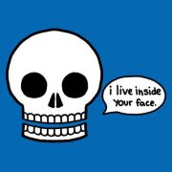
Skeletal System
Chapter 6.1
Human Anatomy & Physiology

Slide 2
Overview of Skeletal System
Bones
Joints
Cartilage
Skeletal System
Tendons (bone to muscle)
Ligaments (bone to bone)

Slide 3
Function of the Skeletal System
Support of the body
Protection of soft organs
Movement due to attached skeletal muscles
Storage of minerals and fats
Blood cell formation

Slide 4
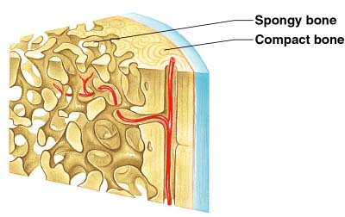
Types of Bone Tissue
Compact Bone: Hard outer layer of bone
Spongy bone: Less dense, small needle-like pieces of bone (trabeculae) with many open spaces
Bone marrow: Soft tissue inside bone that produces blood cells

Slide 5
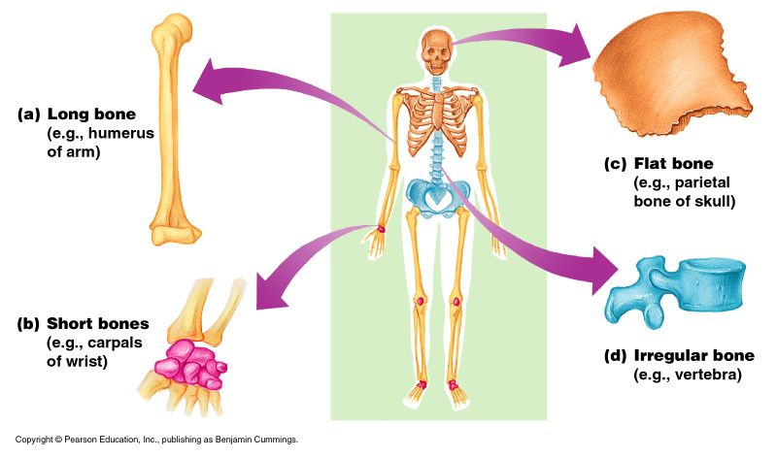
Classification of Bone
Bones are classified according to shape

Slide 6
1. Long Bones
Typically longer than wide
Have a shaft with heads at both ends
Contain mostly compact bone
Examples: Femur, humerus

Slide 7
2. Short bones
Generally cube-shape
Contain mostly spongy bone
Examples: Carpals, tarsals

Slide 8
3. Flat bones
Thin and flattened
Usually curved
Thin layers of compact bone around a layer of spongy bone
Examples: Skull, ribs, sternum

Slide 9
4. Irregular bones
Irregular shape
Do not fit into other bone classification categories
Example: Vertebrae and hip

Slide 10
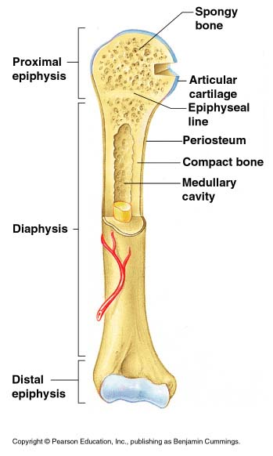
Gross Anatomy of Long Bone
Diaphysis
Shaft
Composed of compact bone
Location of yellow marrow (fat)
Epiphysis
Ends of the bone
Composed mostly of spongy bone
Location of red marrow (blood formation)

Slide 11
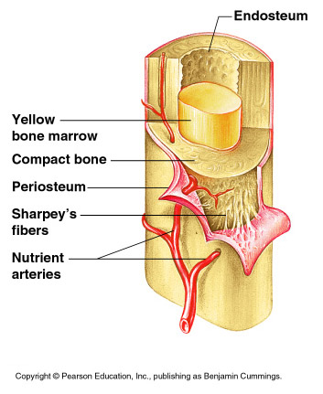
Periosteum
Outside covering of the diaphysis
Fibrous connective tissue membrane
Arteries
Supply bone cells with nutrients

Slide 12
Articular cartilage
Covers the external surface of the epiphyses
Made of hyaline cartilage
Decreases friction at joint surfaces
Medullary cavity
Cavity of the shaft
Contains yellow marrow (mostly fat) in adults
Contains red marrow (for blood cell formation) in infants

Slide 13
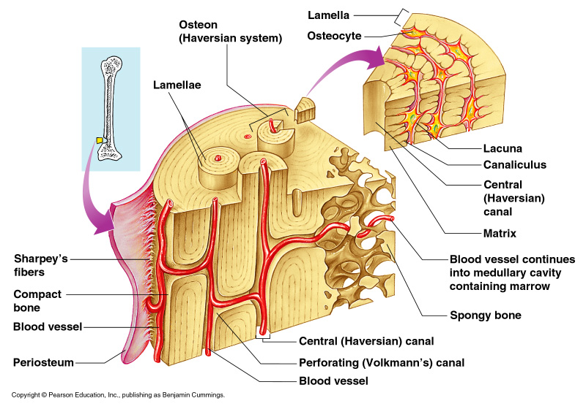
Microscopic Anatomy of the Bone
Osteon (Haversian System)
A unit of bone
Central (Haversian) canal
Opening in the center of an osteon
Carries blood vessels and nerves

Slide 14
Lacunae
Cavities containing bone cells (osteocytes)
Arranged in concentric rings
Lamellae
Rings around the central canal
Sites of lacunae
Canaliculi
Tiny canals
Radiate from the central canal to lacunae
Form a transport system

Slide 15
Ossification: Bone Growth
Epiphyseal plates allow for growth of long bone during childhood
New cartilage is continuously formed
Older cartilage becomes ossified (changed to bone)
Cartilage is broken down
Bone replaces cartilage
Bones are remodeled and lengthened until growth stops
Bones change shape somewhat
Bones grow in width

Slide 16
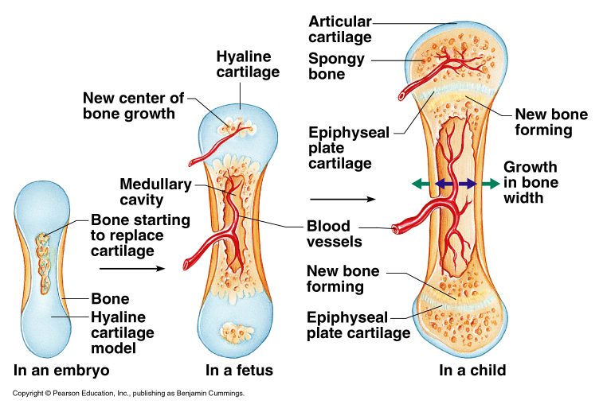

Slide 17
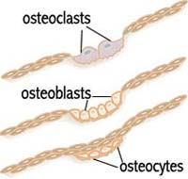
Types of Bone Cells
Osteocytes
Mature bone cells
Osteoblasts
Bone-forming cells for bone growth
Osteoclasts
Bone-destroying cells
Break down bone matrix for remodeling and release of calcium
Bone remodeling is a process done by both osteoblasts and osteoclasts

Slide 18
Ticket out the Door
Identify and Describe the 5 functions of the skeletal system.

Slide 19
Vocabulary Quiz
Write a sentence for each. Include a word that correctly uses the roots below.
Root
Adipo-
Chondro-
Lacuna-
Osteo-
-gli(o/a)
Erythro-
Leuko-
Stria-
Neuro-
Oligo-

Slide 20
Bone Fractures
A break in a bone
Types of bone fractures
Closed (simple) fracture – break that does not penetrate the skin
Open (compound) fracture – broken bone penetrates through the skin
Bone fractures are treated by reduction and immobilization
Realignment of the bone

Slide 21
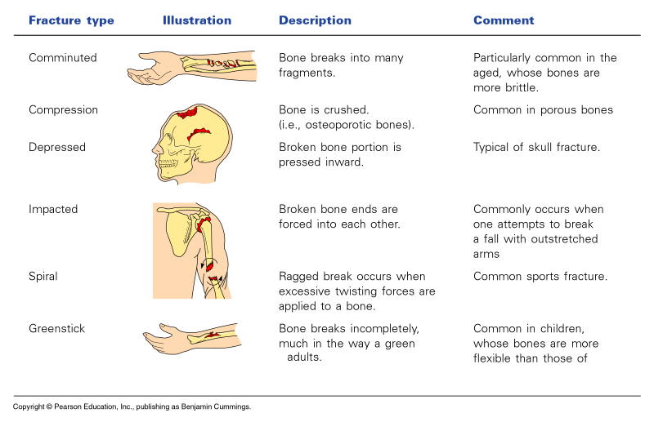
Common Types of Fractures

Slide 22
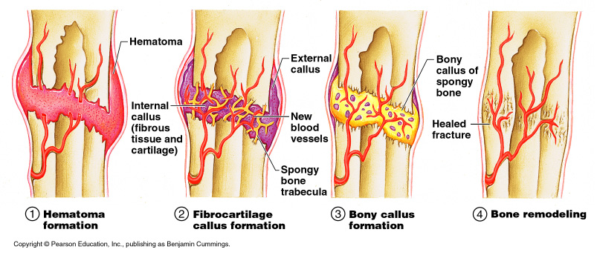
Repair of Bone Fractures
Hematoma (blood-filled swelling) is formed
Break is splinted (immobilized) by fibrocartilage to form a callus
Fibrocartilage callus is replaced by a bony callus
Bony callus is remodeled to form a permanent patch

Slide 23
Human Skeleton

Slide 24
Human Skeleton
206 bones in the adult human body
Divided into 2 parts:
Axial Skeleton
Appendicular Skeleton
Skull
Vertebral column
Rib cage
Bones of arms and legs
Bones of shoulder
Pelvis

Slide 25
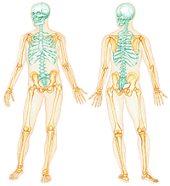
Axial Skeleton
Appendicular Skeleton

Slide 26
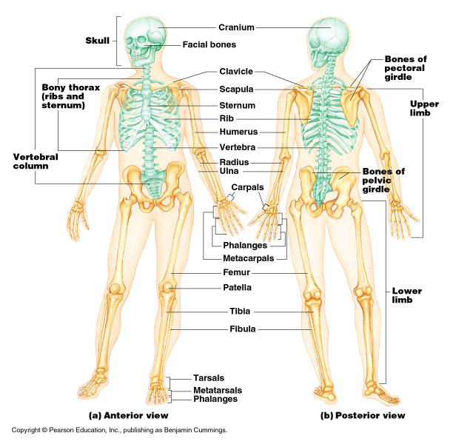
The Axial Skeleton
Divided into three parts
Skull
Vertebral column
Rib Cage (bony thorax)

Slide 27
The Skull
Two sets of bones
Cranium
Facial bones
Skull bones are joined by sutures
Only the mandible is attached by a freely movable joint

Slide 28
Bones of the Cranium (Skull)
Protects the brain
Bones are attached by immovable joints called sutures
Made up of 8 flat bones
1 frontal bone
2 parietal bones
1 occipital bone
2 temporal bones
Foramen Magnum – opening in the occipital bone
Area where spinal cord joins the brain

Slide 29
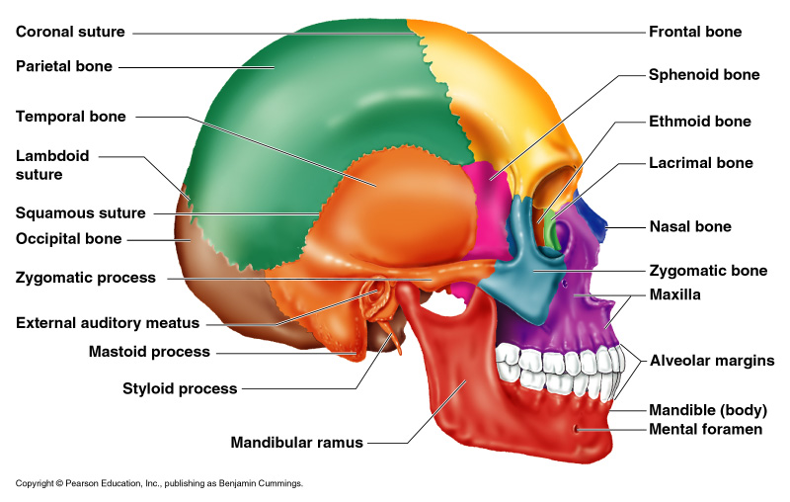
Lateral View of Skull

Slide 30
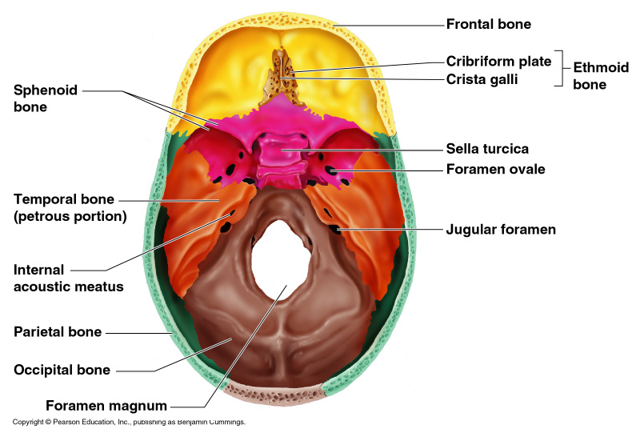
Superior View of Skull

Slide 31
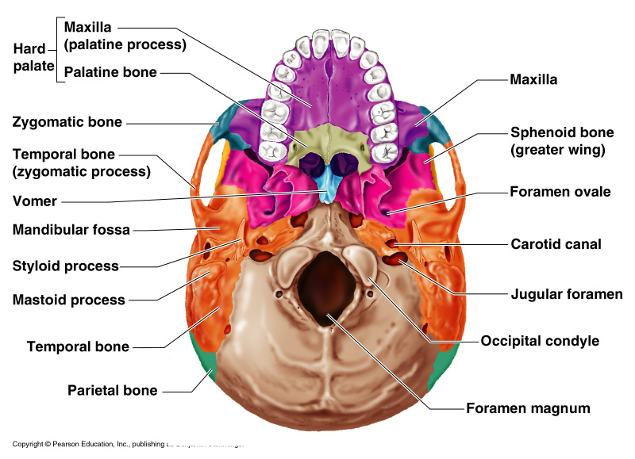
Inferior View of Skull

Slide 32
The Fetal Skull
Fontanelles – fibrous membranes connecting the cranial bones
Allow the brain to grow
Convert to bone within 24 months after birth

Slide 33
Facial Bones
Maxilla
2 bones that form the upper jaw
Mandible
Lower jaw
Only movable bone of the skull
Contains tooth sockets for 16 teeth
Nasal bone
Forms bridge of nose
Zygomatic bone
2 cheek bones

Slide 34
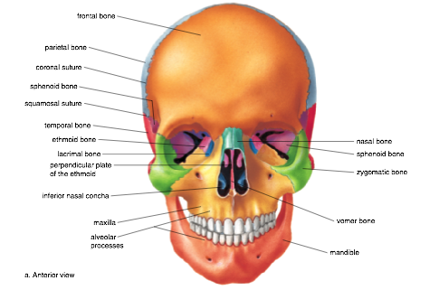

Slide 36
The Vertebral Column
Vertebrae separated by intervertebral discs (pads of fibrocartilage)
The spine has 4 normal curvatures
Each vertebrae is given a name according to its location
Function: protect spinal cord, supports rib cage, attaches to pelvic

Slide 37
The Rib Cage (Bony Thorax)
Forms a cage to protect major organs (heart, lungs)
Made-up of three parts:
1) Ribs
12 ribs connected to the vertebrae
True ribs:
Ribs that connect directly to the sternum
False ribs:
Ribs that attach to the sternum by a common cartilage
Floating ribs:
Ribs that do not attach to the sternum

Slide 38
2) Sternum
Flat, blade-shaped bone
Composed of 3 bones: manubrium, body, xiphoid process
Xiphoid process
Inferior and smallest portion of sternum
Attachment site for diaphragm
3) Thoracic vertebrae
12 thoracic vertebrae

Slide 39
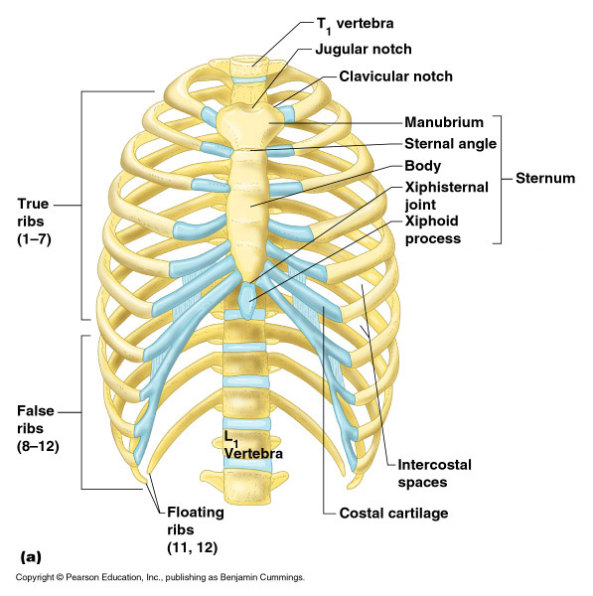

Slide 40
Vocabulary Quiz
Write a sentence for each. Include a word that correctly uses the roots below.
Root | Root
-uria | Clast-
-emia | Blast-
-itis
Arthrlo-
Oss-
Dia-
-physis
Medull(o/a)-
Ax-
Append-

Slide 41
The Appendicular Skeleton
Composed of:
Pectoral girdle
Limbs (appendages)
Pelvic girdle

Slide 42
The Pectoral (Shoulder) Girdle
These bones allow the upper limbs to have exceptionally free movement
Composed of 4 bones
- 2 Clavicles – collarbone
Slender and s-shaped
Stabilizes shoulder but structurally weak (breaks easily) ☹
- 2 Scapulas – shoulder blade
Triangular shape

Slide 43
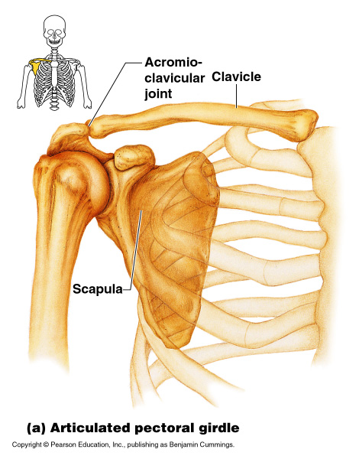
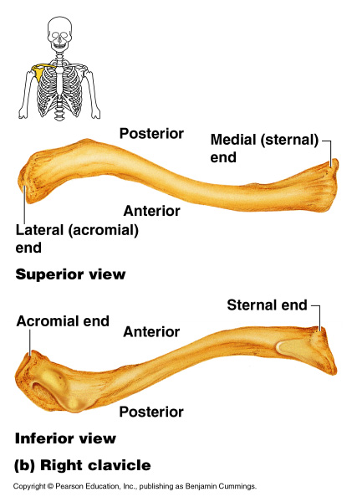

Slide 44
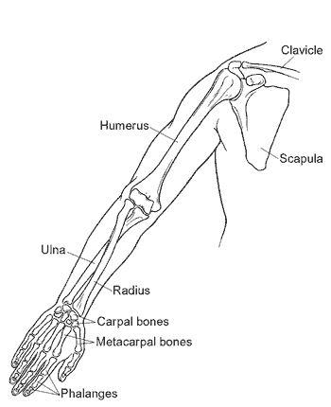
Bones of the Upper Limb
Humerus (upper arm)
Radius and ulna (forearm)
Carpals, metacarpals, phalanges (hand)

Slide 45
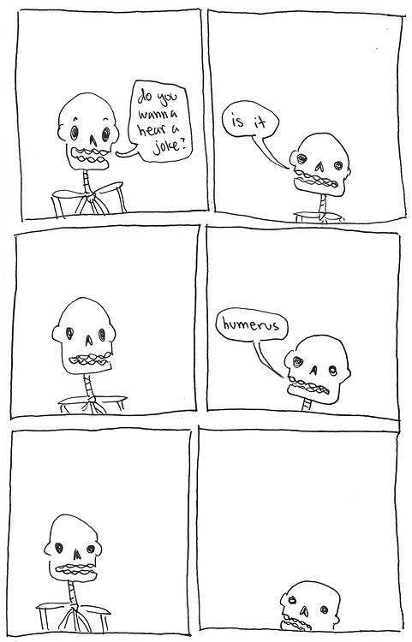
The upper arm is formed by a single bone
Humerus

Slide 46
The forearm has two bones
Ulna
Radius

Slide 47
The hand
Carpals – wrist
Metacarpals – palm
Phalanges – fingers

Slide 48
Bones of the Pelvic Girdle
Hip bones
Composed of:
2 coxal bones (hipbones)
Sacrum
Coccyx
The total weight of the upper body rests on the pelvis
Protects several organs
Reproductive organs
Urinary bladder
Part of the large intestine

Slide 49
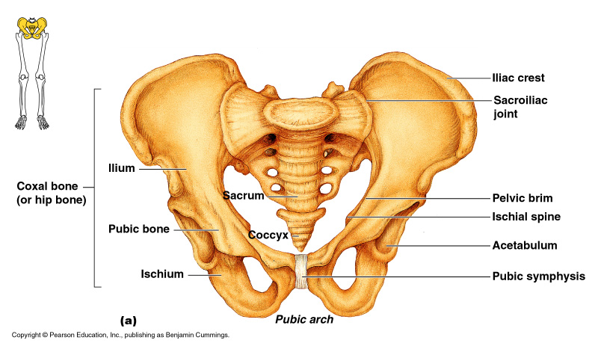

Slide 50
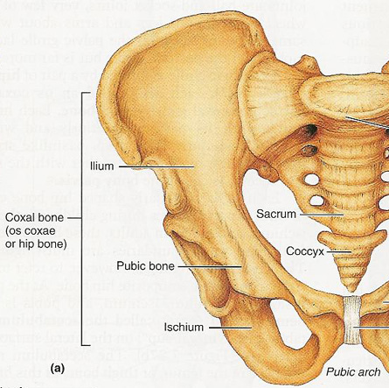
Coxal bone:
- Ilium: largest part of coxal bone
Iliac crest: top of the ilium
- Ischium: most inferior part of the coxal bone
- Pubis: anterior part of coxal bone
Pubic symphysis: where the 2 pubic bones meet

Slide 51
Gender Differences of the Pelvis
Male:
Not as wide or broad
Pelvic cavity is funnel-shaped
Bones are heavier & larger
Pubic arch more narrow
Female:
Wider pelvis & broader hips
Pelvic cavity is shallow
Bones are lighter & thinner
Pubic arch is wider

Slide 52
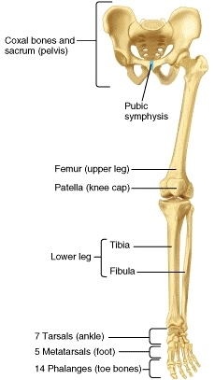
Bones of the Lower Limb
Femur (thigh)
Patella (kneecap)
Tibia & Fibula (leg)
Tarsals, metatarsals, phalanges (foot)

Slide 53
Femur
Thigh bone
Strongest and longest bone in the body
Patella
Triangular bone that protects the knee joint

Slide 54
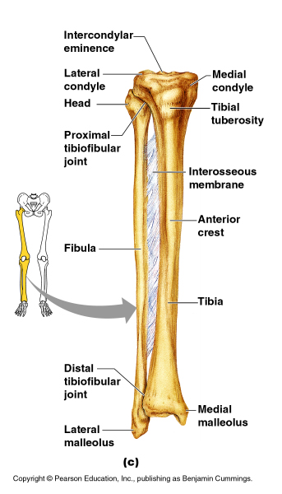
Tibia
Shinbone
Medial (towards the middle) to the fibula
Thicker – bears weight of femur
Fibula
Lateral (away from midline) to the tibia
Stabilize ankle

Slide 55
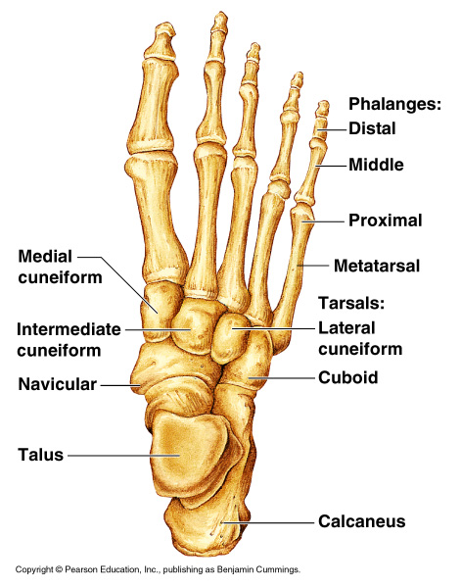
The foot
Tarsal bones
Ankle
Supports weight of body
Metatarsals
Sole or instep
Phalanges
Toes

Slide 56
Ticket out the Door
1. Summarize the parts of the Appendicular Skeleton.
2. Describe the differences between the male and female pelvis.

Slide 57
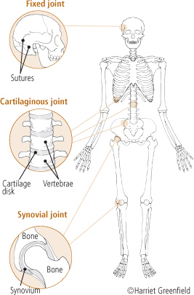
Joints
Fibrous Joint
Articulations (attachments) of bones
Functions of joints
Hold bones together
Allow for mobility
Joints are classified by the amount of movement allowed

Slide 58
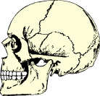
Structural Classification of Joints
Fibrous joints
Generally immovable
Fibrous connective tissue join bone to bone
Example: cranium bones

Slide 59
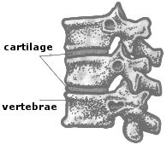
Cartilaginous joints
Immovable or slightly moveable
Fibrocartilage found between bones
Example: ribs/sternum, vertebrae, pelvis

Slide 60
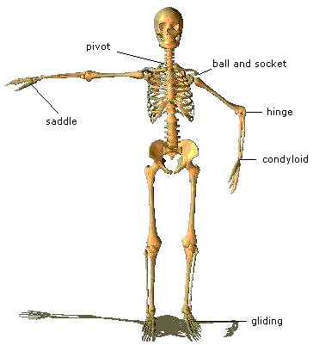
Synovial Joints:
Freely movable joints
Bones do not come in contact with each other
6 Types

Slide 61
Joint Vocabulary
Ligaments
Connective tissue that connects bone to bone
Tendons
Connect bone to muscles to further stabilize joint
Synovial fluid
Lubricating fluid found between bones to reduce friction
Bursae
Fluid-filled sacs that cushion joint (ex. knee)
Meniscus
Cartilaginous pads of tissue between the tibia and femur in knee joint

Slide 62
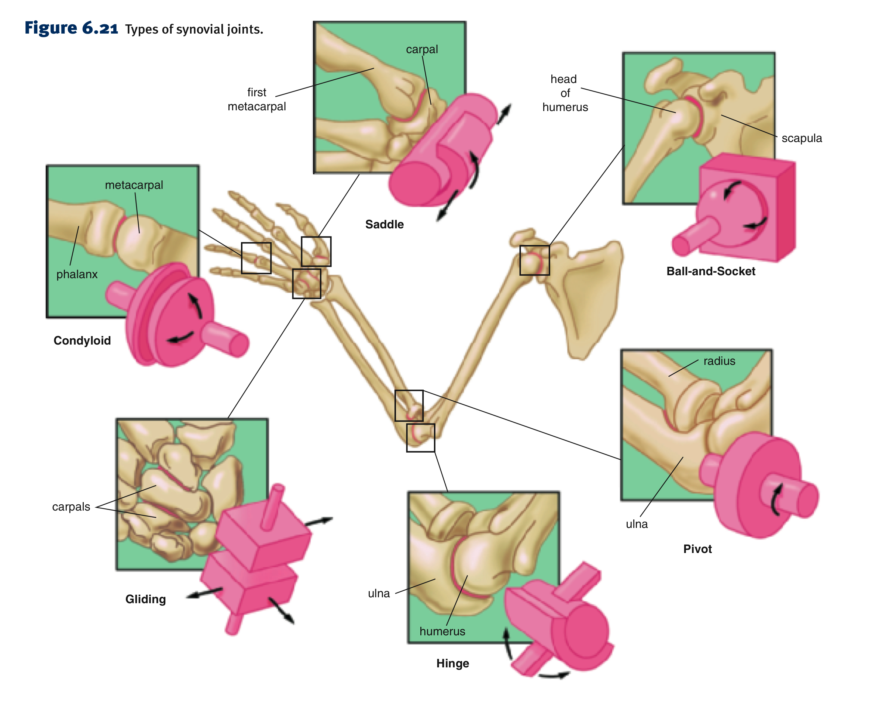

Slide 63
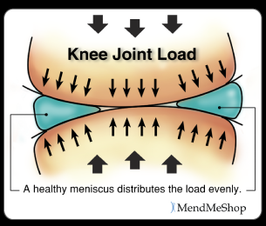
Knee Injuries
Torn Meniscus
The menisci absorb shock by compressing and spreading the weight evenly within the knee.
The menisci are attached to the tibia and joint and ligaments, allowing the menisci to pivot freely.
One of the most common knee injuries.
Grow weaker with age, and tear as a result of minor injuries or movements.
The most common injury occurs when the knee joint is bent and the knee is then twisted.

Slide 64
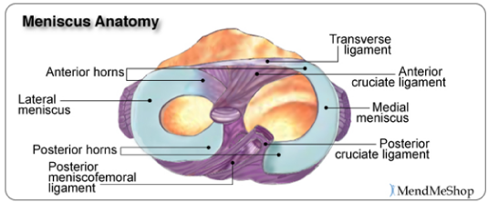
A damaged meniscus can cause it to become caught between the bones of the joint (femur and tibia).
Symptoms: Knee then becomes swollen, painful, popping or clicking with the knee, and difficult to move.
Treatment: Surgery to repair tear by trimming a portion of the meniscus (meniscectomy).

Slide 65
Knee Injuries Cont.
2. Torn ACL (Anterior Cruciate Ligament)
ACL provides stability to the joint
Common injury in athletes in contact sports
Occurs when the knee is locked with the foot planted and the knee is twisted quickly.
The bones are more likely to rub against each other (chronic ACL deficiency).
Can also damage the cartilage that covers the ends of the bones and can trap and tear the menisci.
Left untreated it can lead to osteoarthritis.

Slide 66
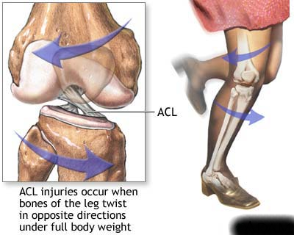
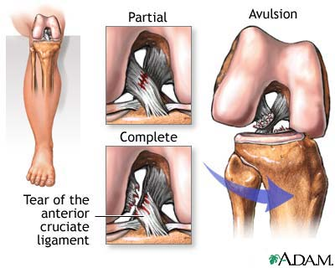

Slide 67
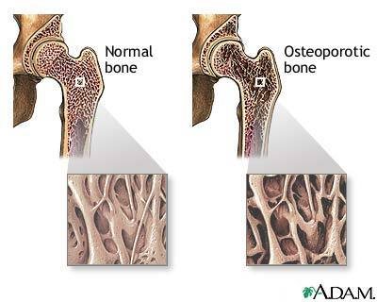
Disorders of the Skeletal System
Osteoporosis
Most common bone disease
1 in 5 women in USA over 50
have osteoporosis
Men over 70 are at risk
During menopause, estrogen levels drop
Body stops making new bone due to lack of calcium, resulting in brittle bones and fractures

Slide 68
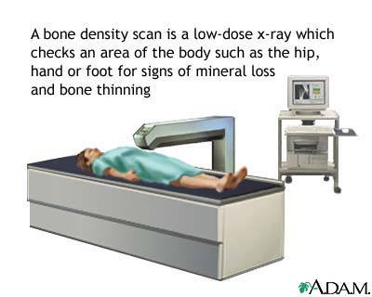
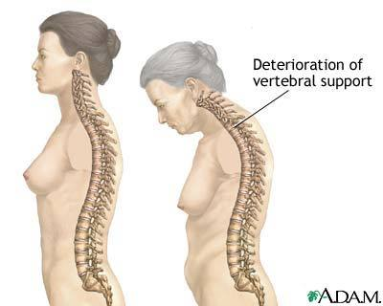
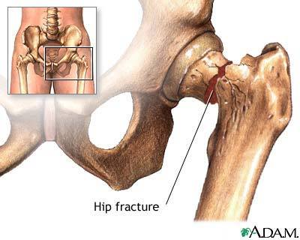
Osteoporosis

Slide 69
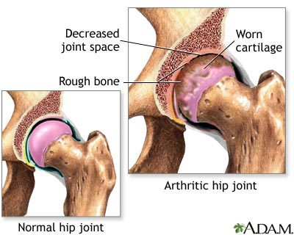
Arthritis
Inflammation of one or more joints
Breakdown of cartilage causes bones to rub together, leading to pain, inflammation, and stiffness
There are many different types of arthritis

Slide 70
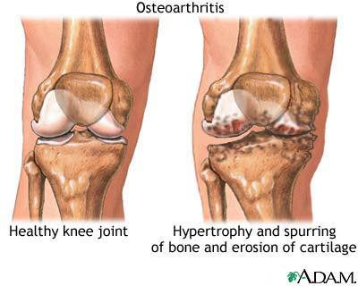
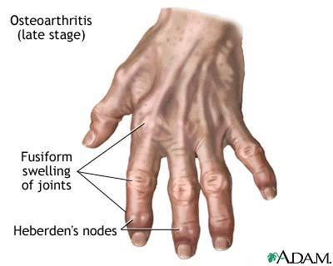
Arthritis
Osteoarthritis (OA)
Most common type of arthritis
Caused by ‘wear and tear’ on joint
Cartilage breaks down and bony spurs may develop
Runs in families

Slide 71
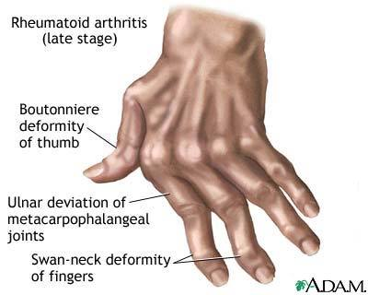
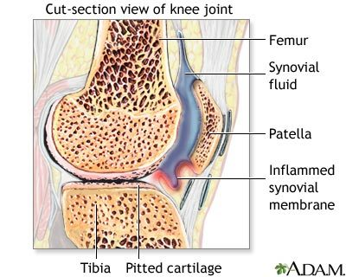
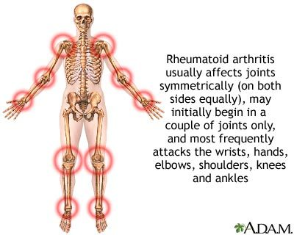
Arthritis
Rheumatoid arthritis (RA)
Autoimmune disease
Body mistakenly attacks healthy tissues, breaking down cartilage
Common in middle aged people
Women get RA more than men

Slide 72
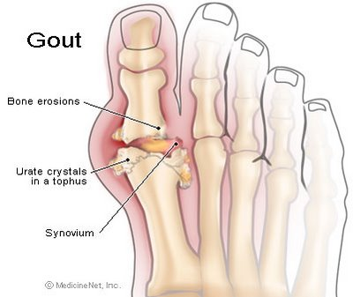
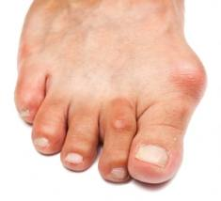
Arthritis
Gout
Type of arthritis that occurs when uric acid builds up in the blood, causing crystals to form in the joint
Leads to major inflammation
More common in men, women after menopause, and those who drink alcohol

Slide 73
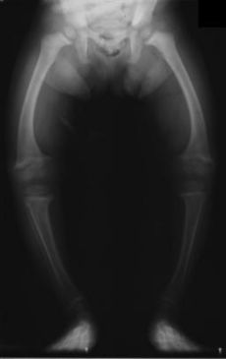
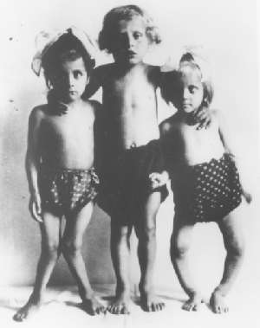
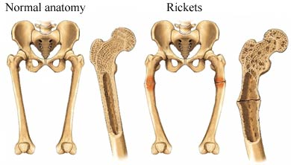
Rickets
Uncommon
Caused by a lack of Vitamin D, calcium, or phosphate, leading to a weakening and deformation of bones
Vitamin D deficiency caused by lack of sunlight or rare genetic X-linked dominant trait

