Slide 1
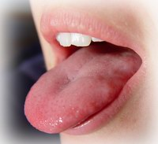
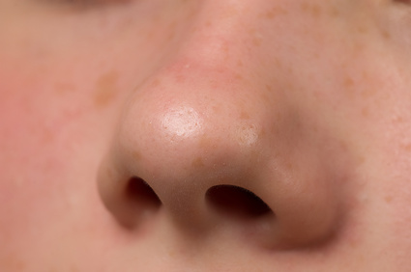
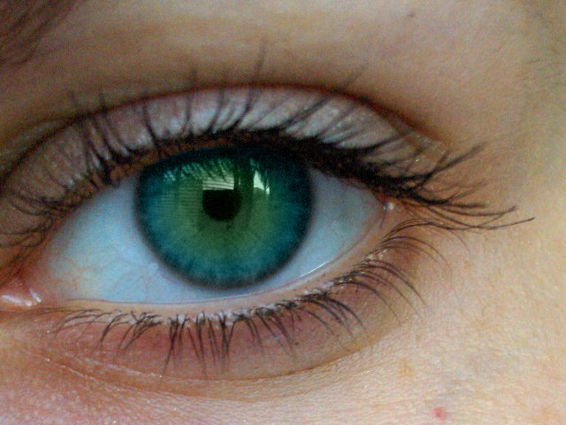
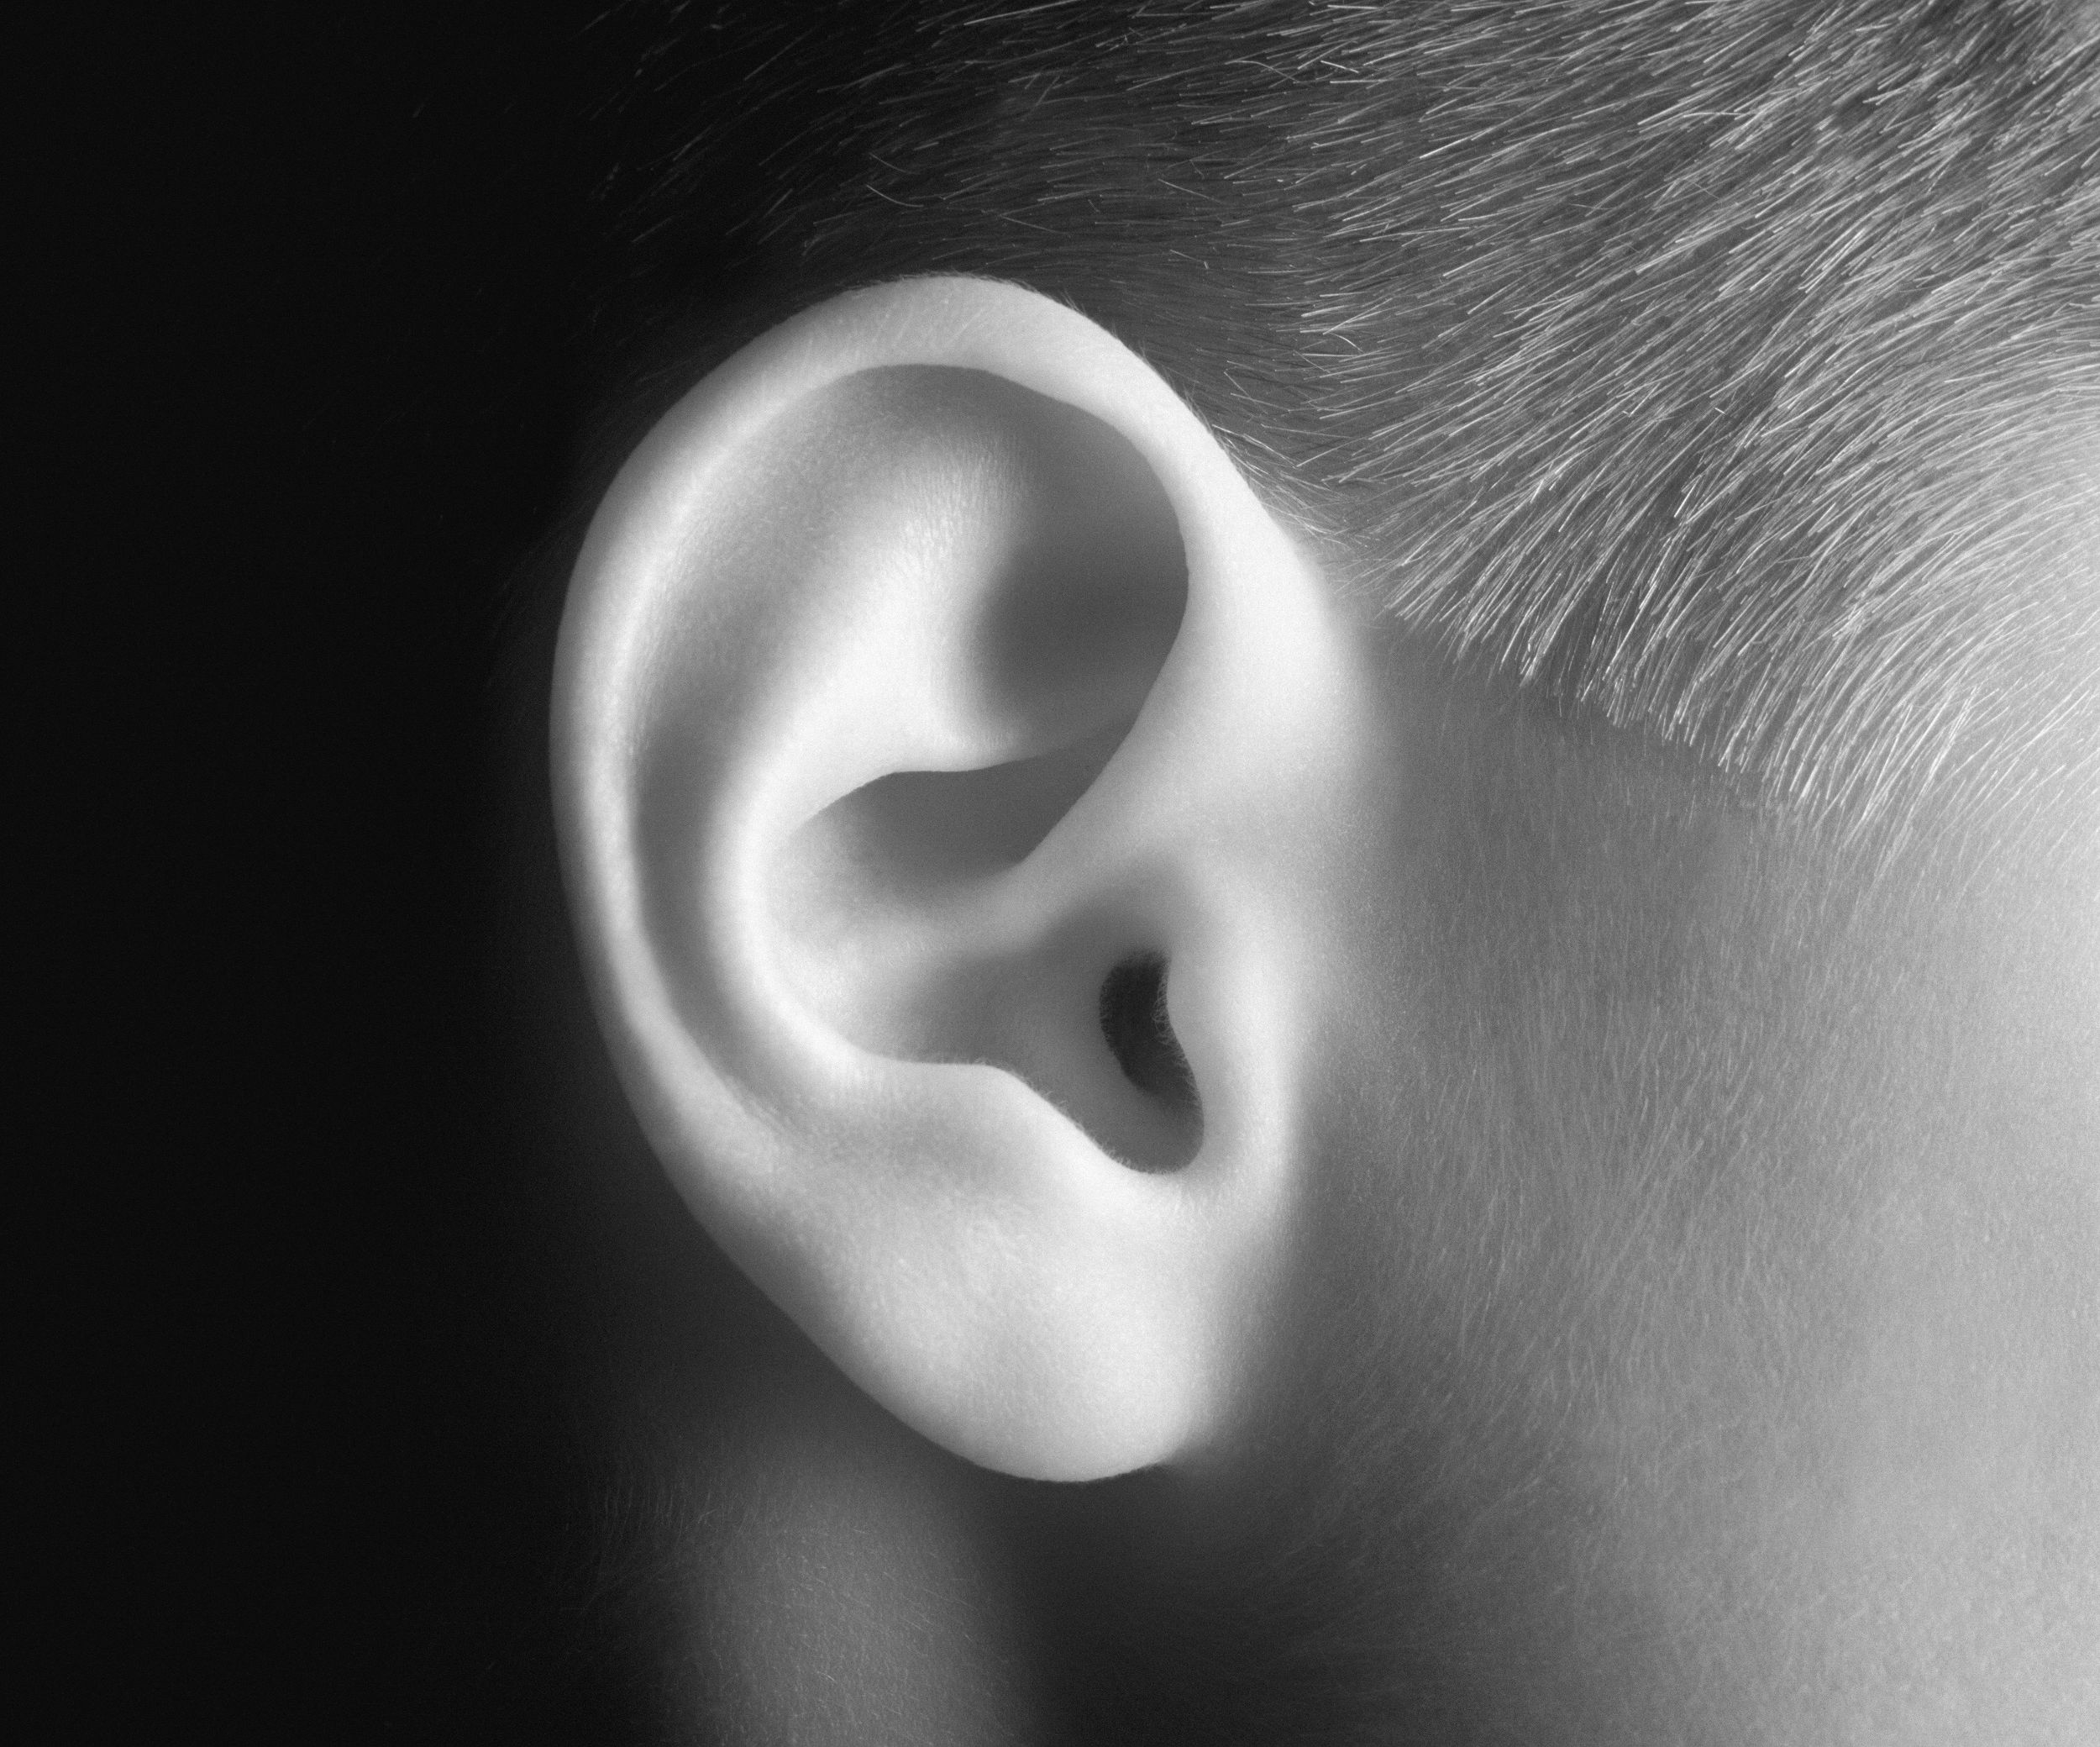
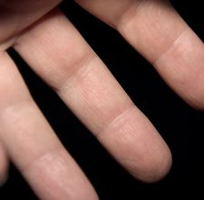
Sensory System
Chapter 9

Slide 2
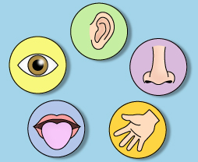
Sensory Organs
Sense | Organ
Touch | Skin (external)
Taste | Tongue
Smell | Nose
Hearing/Equilibrium | Ears
Sight | Eyes

Slide 3
The Sensory System
The central nervous system receives information from the internal and external environment via the sensory organs.
Sensory organs are able to “sense” this information because of specialized receptors.
When a receptor is triggered, it causes an action potential in the sensory neuron.

Slide 4
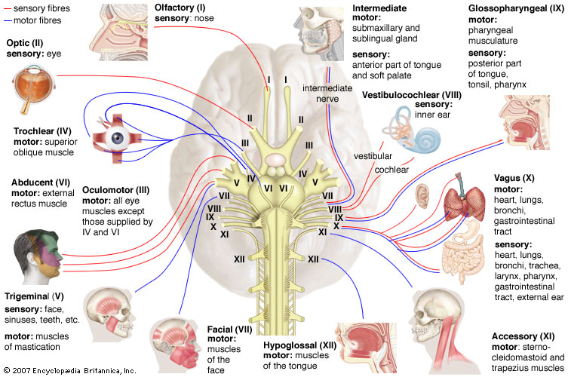

Slide 5
Types of Sensory Receptors
1. Mechanoreceptors – stimulated by changes in pressure or movement
Found in skin and muscles
2. Thermoreceptors – stimulated by changes in temperature
Found in skin
3. Pain receptors – stimulated by tissue damage
Found in skin and viscera

Slide 6
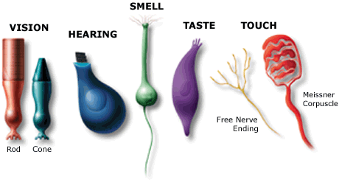
Types of Sensory Receptors (continued)
4. Chemoreceptors – stimulated by changes in chemical concentration of substances
Used for taste and smell
5. Photoreceptors – stimulated by light
Found only in the eye

Slide 7
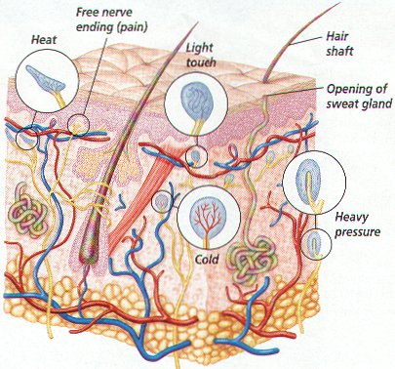
Sense of Touch
Mechanoreceptors in the skin and viscera detect varying degrees of pressure.
Free nerve endings have pain receptors and thermoreceptors.

Slide 8
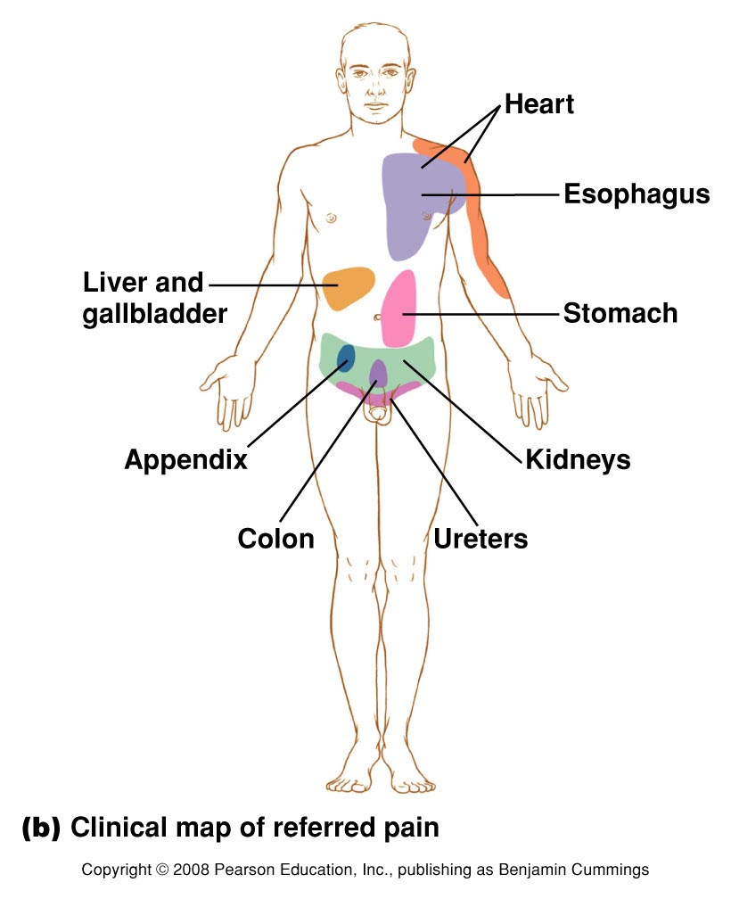
Sense of Touch – Pain
Pain is caused by chemicals released by inflamed tissues.
Aspirin and ibuprofen reduce pain by blocking synthesis of these chemicals
Referred pain – inside the body’s organs, pain is often felt in another area.
Ex: Pain from the heart is felt in the left shoulder and arm

Slide 9
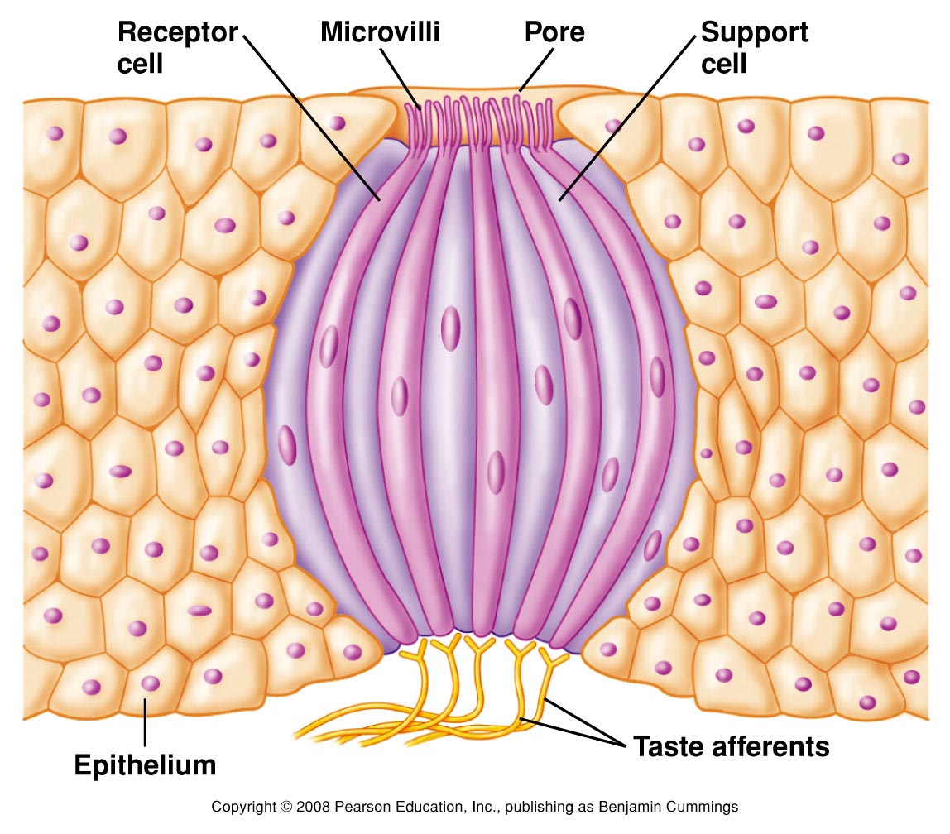
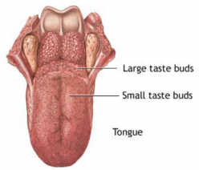
Senses of Taste & Smell
Taste and smell are “chemical senses”
Taste – tastebuds containing chemoreceptors are found in the epithelium of the tongue
Papillae (bumps) on the tongue contain many receptors
Receptors can distinguish between sweet, sour, salty, and bitter tastes.

Slide 10
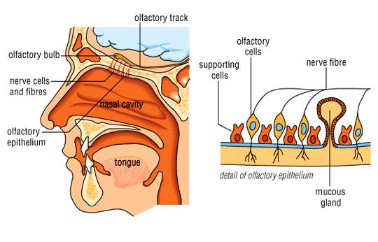
Senses of Taste & Smell
Smell – within the nasal cavity, chemoreceptors in the olfactory bulb are stimulated by odor molecules

Slide 11
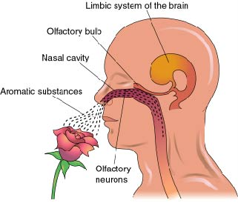
Senses of Taste & Smell
Smells have been shown to be linked to memories because the olfactory bulb is linked to the limbic system of the brain.

Slide 12
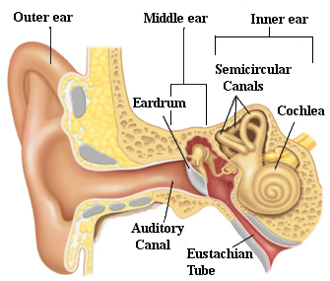
Sense of Hearing
Anatomy of the Ear
1. Outer Ear – includes:
pinna (external ear)
auditory canal

Slide 13
Sense of Hearing
Anatomy of the Ear
2. Middle Ear- includes:
Eardrum (tympanic membrane)
Ossicles – 3 small bones
1) Malleus (hammer)
2) Incus (anvil)
3) Stapes (stirrup)
Eustachian tube – equalization of air pressure (“pops” ear)

Slide 14
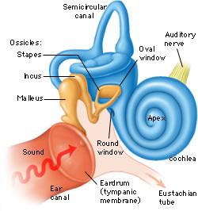
Sense of Hearing
Anatomy of the Ear
3. Inner Ear – includes:
Semicircular canals – involved with equilibrium
Cochlea – snail-shaped structure involved with hearing

Slide 15
Sense of Hearing
How we Hear
1. Sound waves travel through the auditory canal to the eardrum.
2. The sound waves cause the eardrum to vibrate.
3. The vibration causes the malleus (hammer) to hit the incus (anvil) and then the stapes (stirrup).
4. The vibration passes to the fluid in the cochlea of the inner ear.
5. Each part of the spiral cochlea is sensitive to different frequencies of sound.
6. The auditory nerve takes impulses to the brain.

Slide 16
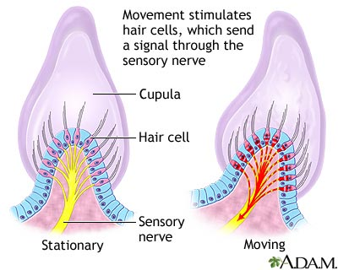
Sense of Hearing
Equilibrium
Mechanoreceptors in the semicircular canals detect rotation and movement of the head
Little hair cells send information to the brain to cause appropriate motor output so as to correct position when it is unbalanced.
Vertigo (dizziness)

Slide 17
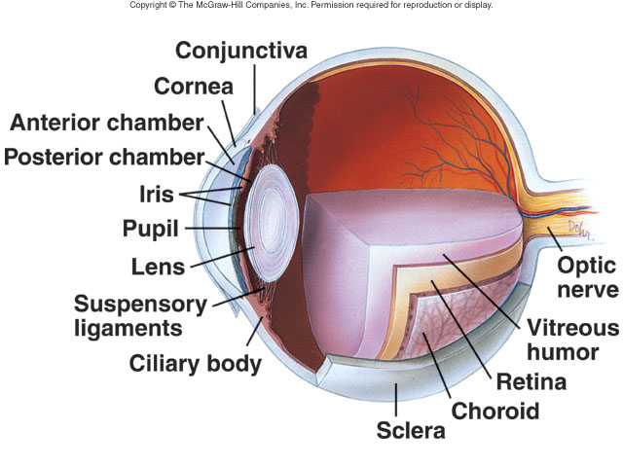
Sense of Sight
Anatomy of the Eye
Sclera – protection (white of eye)
Cornea – refracts light
Vitreous humor – maintains eyeball shape
Retina
Rods – black & white vision
Cones – color vision
Optic nerve – sends impulses to brain

Slide 18
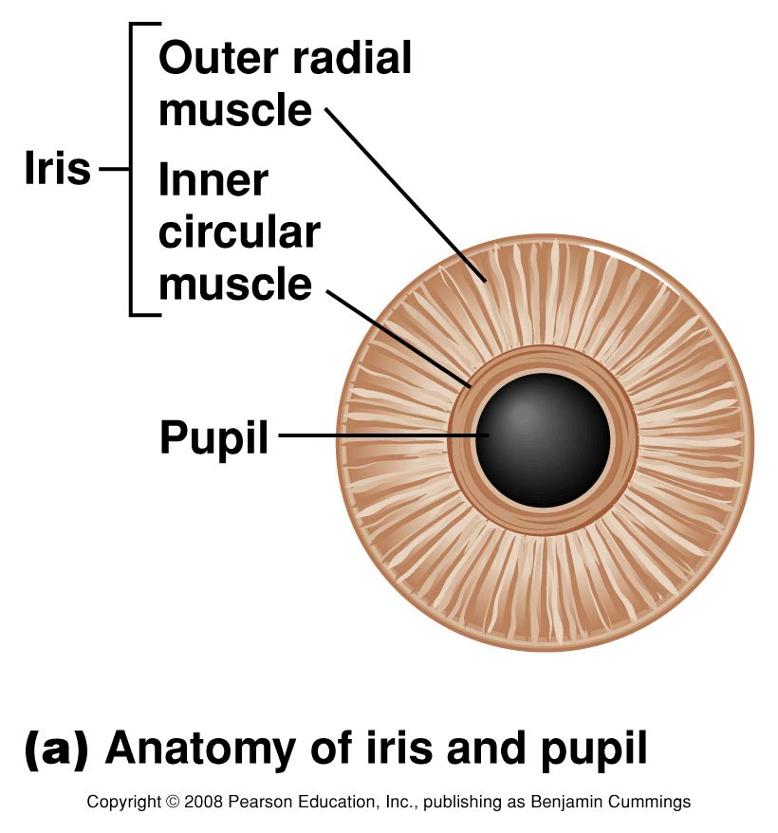
Sense of Sight
Anatomy of the Eye
Lens – focuses light
Cilliary body – holds lens in place, accommodation
Iris – regulates light entrance (muscle)
Pupil – admits light

Slide 19
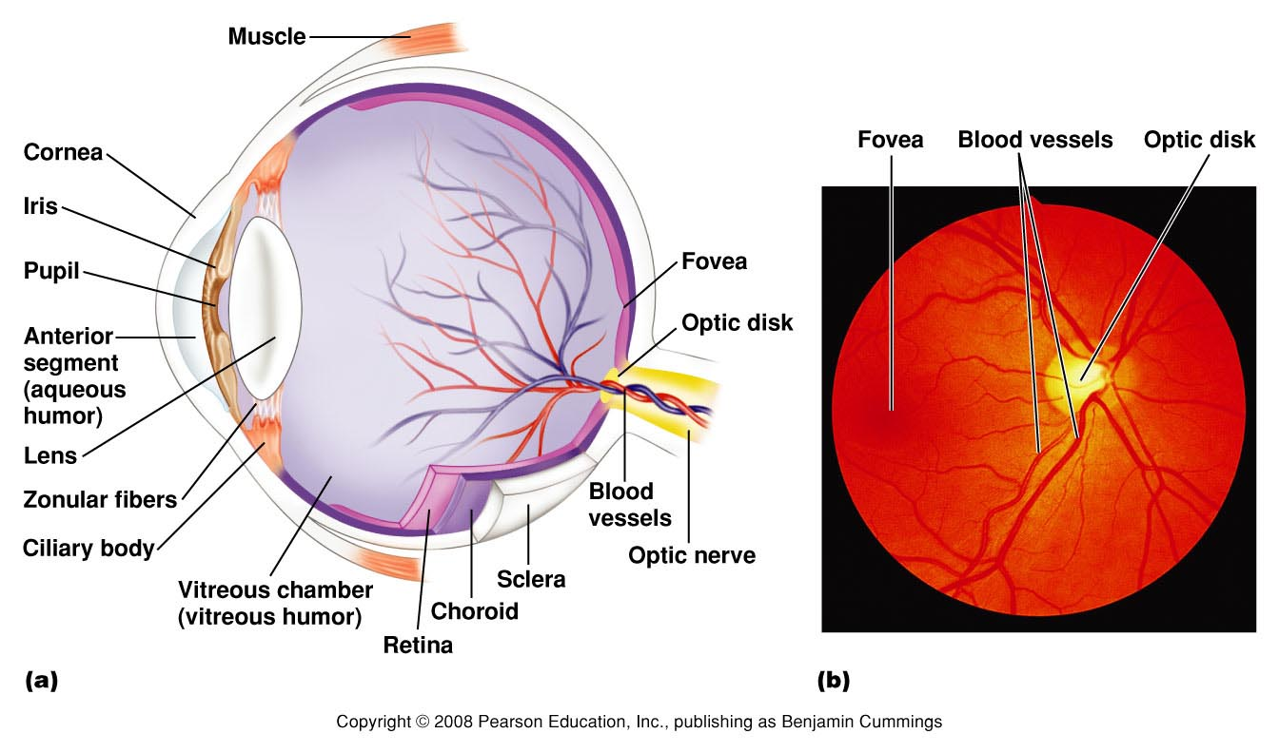

Slide 20
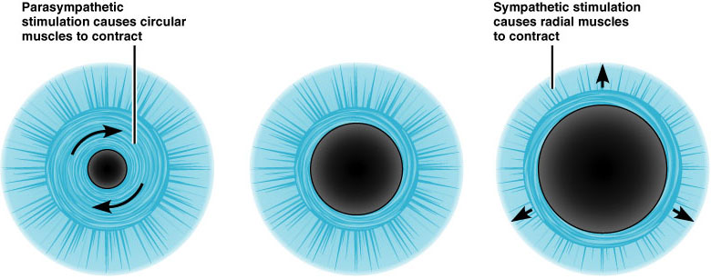
Sense of Sight
How we see
1. Light enters through the pupil.
The iris can contract or dilate to allow different amounts of light into the eye.

Slide 21
Sense of Sight
How we see
2. Light passes through the lens and vitreous humor to the back of the eye, the retina.
The lens can change shape to focus light through accommodation.
Object is far → the lens flattens
Object is near → the lens rounds

Slide 22
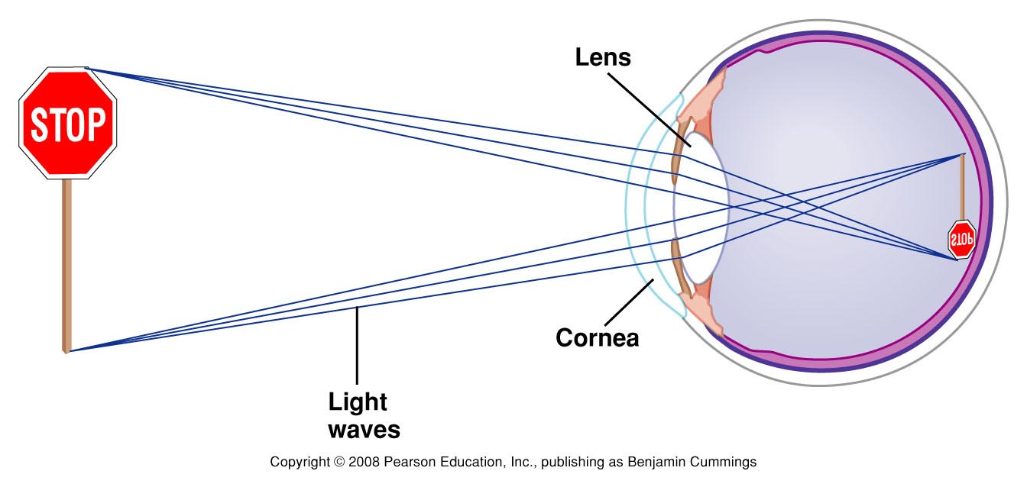
Sense of Sight
How we see
The image projected from the lens on the back of the eye is upside down.

Slide 23
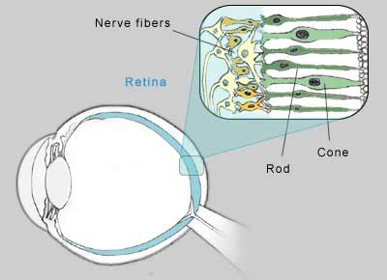
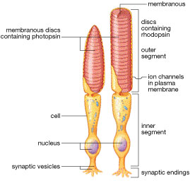
Sense of Sight
How we see
3. The retina has photoreceptor cells that detect light and send impulses to the brain.
Rods – black and white vision
sensitive to light; night vision
Cones – color vision & detail
Sensitive to bright light
Blue, green, and red pigment cones detect different wavelengths of light

Slide 24
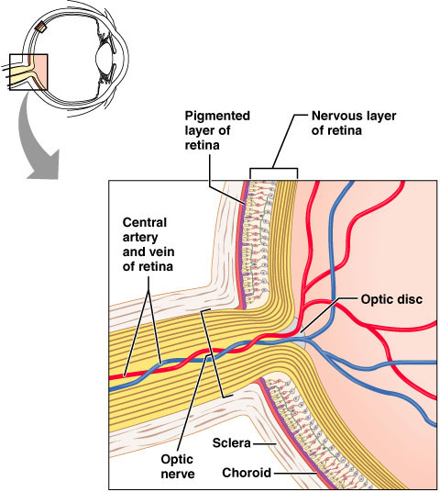
Sense of Sight
How we see
4. Impulses from the rods and cones in the retina are sent to the optic nerve
This spot on the retina has not rods or cones and creates a blind spot.

Slide 25
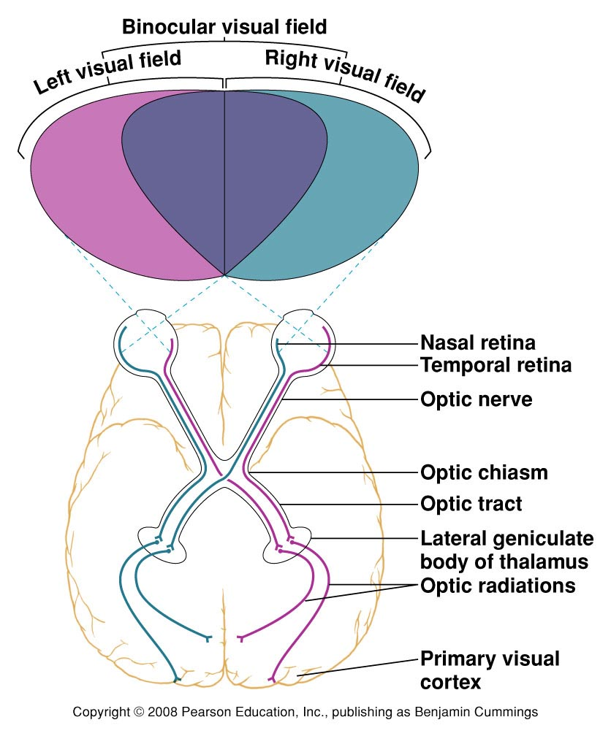
Sense of Sight
How we see
5. The optic nerves from each eye cross at the optic chiasm.
Input from the right eye goes to the left occipital lobe
Input from the left eye goes to the right occipital lobe
6. Visual integration centers in the occipital lobe process visual input.

Slide 26
Vision Disorders
Farsightedness: trouble seeing close-up
eye too short and/or lens too weak
light focuses behind retina
correct with “convex” lens to add power
Nearsightedness: trouble seeing far away
eye is too long and/or lens is too powerful
light focuses in front of retina
correct with “concave” lens to reduce power

Slide 27
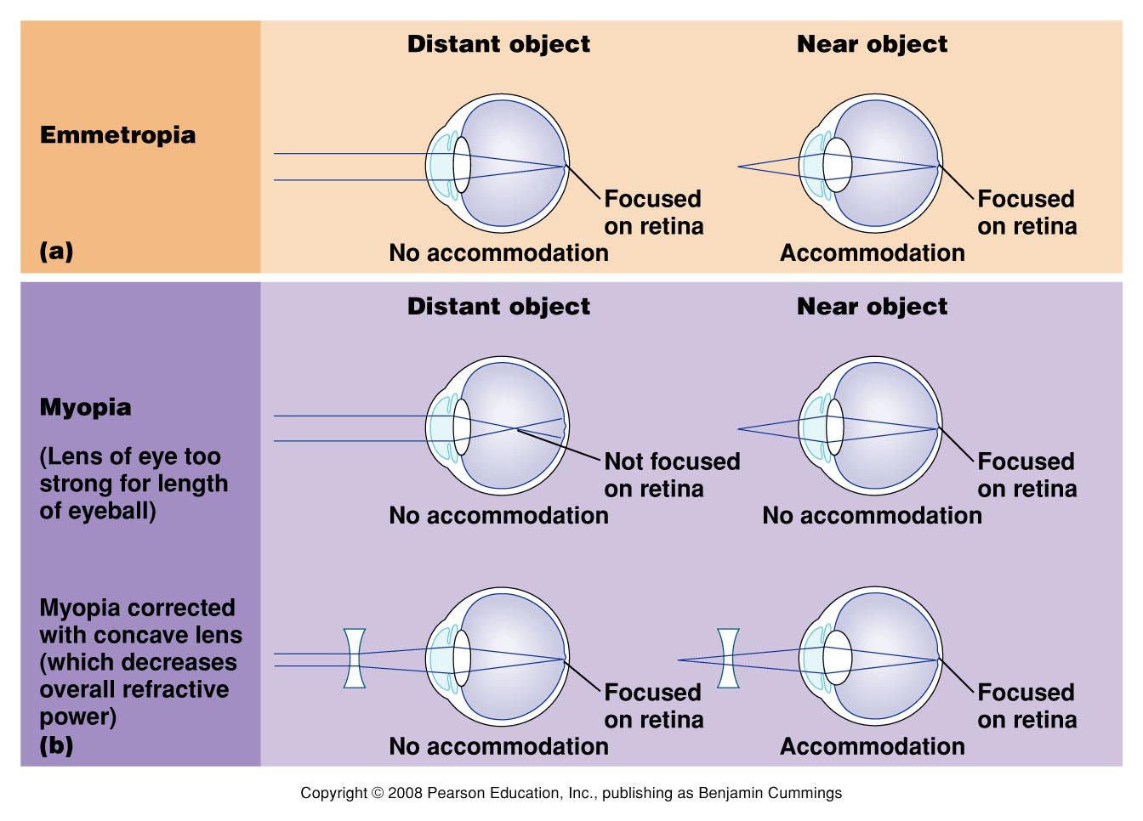

Slide 28
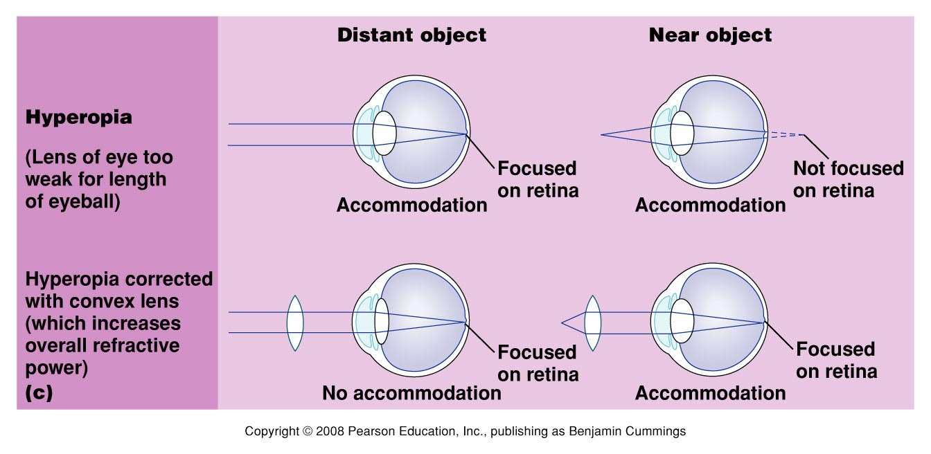

Slide 29
Presbyopia: Oldsightedness
The crystalline lens tends to harden with age
The near point of distinct vision moves further and further away from the eye with age.

Slide 30
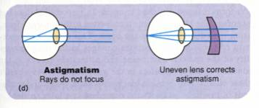
Astigmatism
Abnormal curvature of the cornea
Light from vertical and horizontal direction do not focuses in the same point
Correct with “cylindrical” lens to compensate

Slide 31
Color Blindness
Red-green color-blindness – occurs when red or green cones or pigments are missing
Due to sex-linked gene (on X chromosomes) so more common in men.
Non-sex-linked condition
Blue-color blindness- missing blue cones or pigments
Monochromats: people who are totally colorblind, more severe

Slide 32
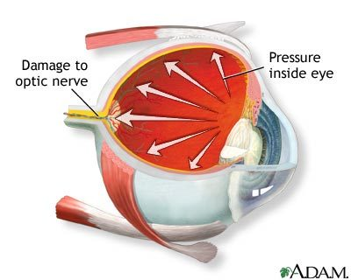
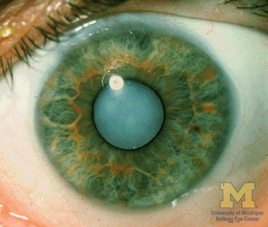
Disorders of the Eye
Glaucoma
Damage to the optic nerve occurs due to increased eye pressure
Can lead to blindness
Cataracts
Clouding of the lens that affects vision
Very common in older people
Figure 10.27b

