Slide 1
Unit 7: Mineral and Energy Resources
Minerals, Renewable/Nonrenewable Energy, and Waste
Unit driving question: How can we adequately provide for all humans without abusing Earth’s natural resources ?

Slide 2
What do you think about…
http://www.youtube.com/watch?v=A3moxr_E7aA –
Is Mining really that important ??? What do we obtain from mining that is invaluable to us as humans ??

Slide 3
Mineral Information Institute Reading
How has the population of the United States affected the kind and amount of minerals used ? What are the potential impacts of obtaining and using these minerals on the environment ?
What is your evidence ?
What order should you present them in to make a logical argument?
What science words will you need to include?
Will you use everyday language or formal school language ?

Slide 4
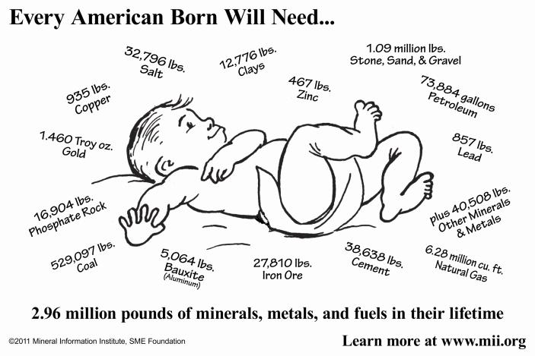
Mining and Mineral Resources
Balancing the overwhelming need for minerals with minimizing the cost to the environment

